Slide 1
Gilbertsville-Mount Upton Central School District 2023-2024 Proposed Budget

Slide 2
Our Vision
To have a nurturing school community that provides opportunities for lifelong personal growth.
Our Mission
We support everyone’s journey to become the best version of themselves by:
fostering an equitable, inclusive, and student-focused environment;
providing opportunities for academic and community engagement;
empowering individuals to embrace their potential.
Our Core Values
* A Growth Mindset * Essential Skills for Career Readiness
* Social/Emotional/Behavioral Wellness *A Safe School Environment
* Critical Thinking Skills * Meaningful and Healthy Relationships

Slide 3
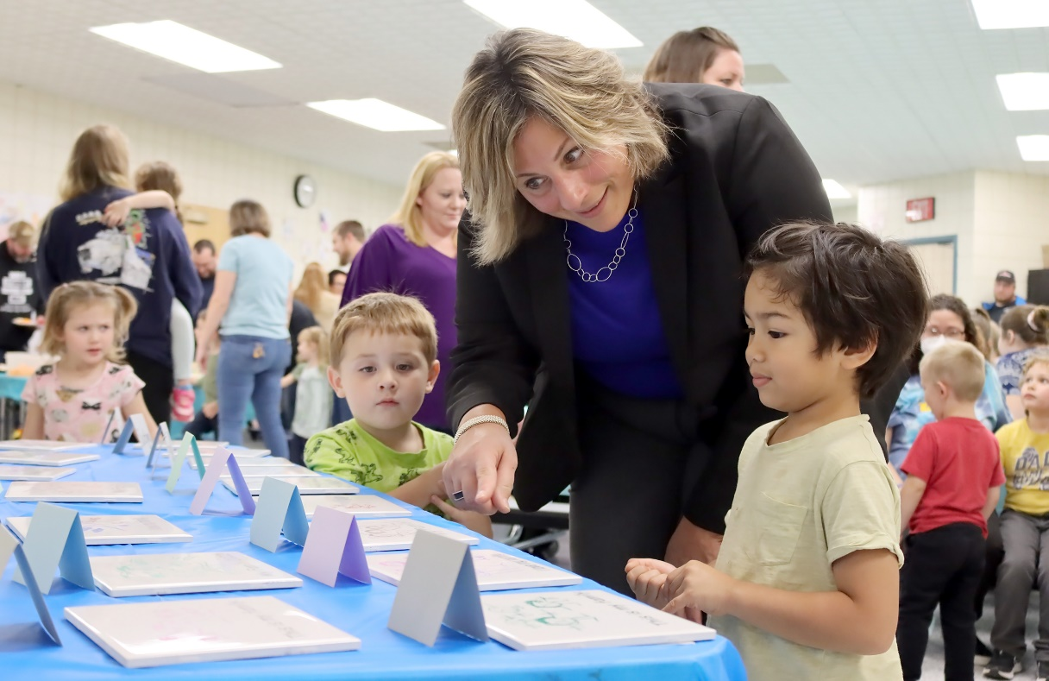
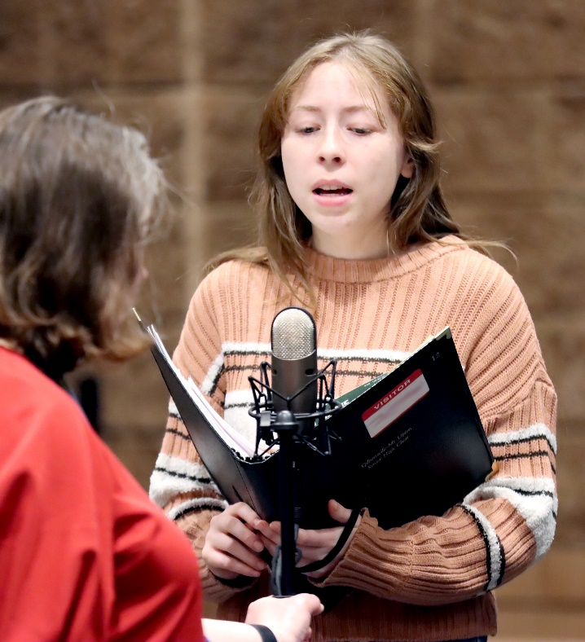
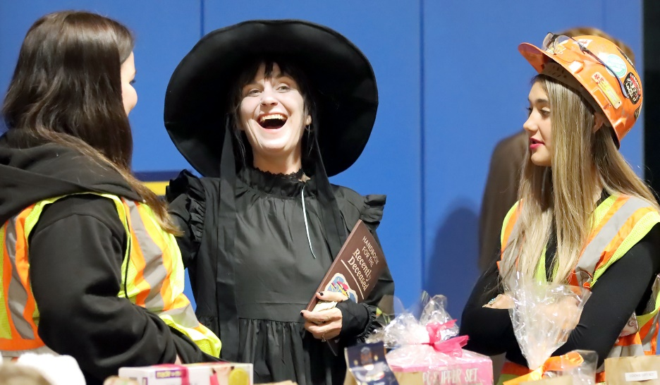
We Are Connecting With Our Kids

Slide 4
Our District Goals
Goal 1
Focus on Academic Instruction and Learning
Goal 2
Focus on Social, Emotional, and Behavior Health
Goal 3
Focus on Diverse Opportunities/Exposure
Goal 4
Focus on Efficient and Effective Systems

Slide 5
Important Budget Considerations
Look to the future … sustainability over time
Employee Contractual Obligations
Ever-changing costs for Special Education & Health Insurance
State Aid to be Received: 2.99% increase ($151,016)
$27,000 adds 1% to the Tax Levy
Poverty Rate of 54%
Increased cost of fuel, electricity, food and overall costs of supplies
Minimum Wage increases
The need to build into the budget items that were grant funded
Community’s desire for an SRO Officer

Slide 6
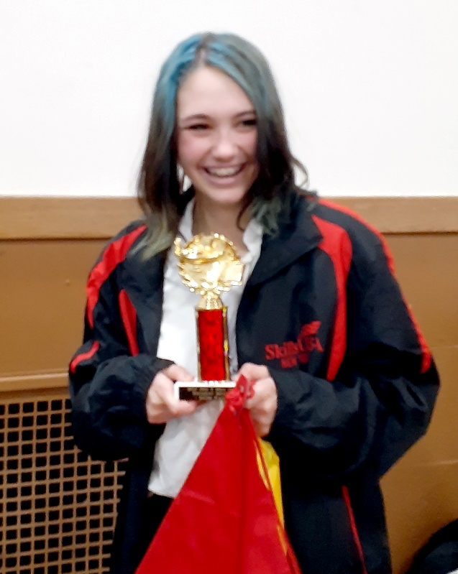
2023-2024 Budget Proposal
2022-23 Budget $10,695,500
2023-24 Budget $11,050,000
Budget-to-Budget Increase 3.31%
Tax Levy 2.00%
(3.17%-Tax Cap)

Slide 7
Where does the money come from?
(Revenue Breakdown)
 | 2022-23 | 2023-24 | Change
FOUNDATION AID | $5,033,879 | $5,184,895 | $151,016
EXPENSE-DRIVEN AIDS
Transportation Aid | $761,567 | $770,257 | $8,690
Textbook/Computer/Software/Library Aid | $32,502 | $32,996 | $494
BOCES Aid | $632,570 | $620,500 | $-12,070
Excess Cost Aid | $64,500 | $66,076 | $1,576
Building Aid | $1,108,832 | $1,108,076 | $-756
OTHER REVENUES
Interest and Penalties on Taxes | $13,500 | $13,500 | 0
Interest on Investments | $1,000 | $55,000 | $54,000
Sale of Transportation Equipment | $12,500 | $12,500 | 0
Refund of Prior Year's Expense | $55,000 | $55,000 | 0
Other Unclassified Revenues | $40,000 | $78,500 | $38,500
Medicaid Reimbursement | $17,500 | $17,500 | 0
Appropriated Reserves/Fund Balance | $275,000 | $335,000 | $60,000
Property Tax Levy | $2,647,150 | $2,700,200 | $53,050
TOTAL REVENUES | $10,695,500 | $11,050,000 | $354,500

Slide 8
We Are Proud To Be Raiders!

Slide 9
Historical Review
District Budget | 2015-16 | 2016-17 | 2017-18 | 2018-19 | 2019-20 | 2020-21 | 2021-22 | 2022-23 | Projected 2023-24
Voter Approved Budget | $8,995,610 | $9,205,500 | $9,305,500 | $9,885,000 | $9,990,305 | $10,195,655 | $10,300,655 | $10,695,500 | $11,050,000
Budget to Budget Increase | 1.55% | 2.33% | 1.09% | 6.23% | 1.07% | 2.06% | 1.03% | 3.83% | 3.31%
Tax Levy | 2015-16 | 2016-17 | 2017-18 | 2018-19 | 2019-20 | 2020-21 | 2021-22 | 2022-23 | 2023-24
Actual Tax Levy | $2,318,615 | $2,355,365 | $2,380,115 | $2,427,365 | $2,476,030 | $2,538,050 | $2,595,150 | $2,647,150 | $2,700,200
Tax Levy Increase | .0% (2.97-cap) | .99% (1.87 cap) | 1.64% (2.35 cap) | 1.99% (3.11 cap) | 2.00% (3.11 cap) | 2.50% (3.56 cap) | 2.25% (2.80 cap) | 2.00% (3.04 cap) | 2.00% (3.17 cap)

Slide 10
Gilbertsville-Mount Upton CSD
Where the Quality of the journey counts!
Vote: At GMU School (park in the front circle)
When: May 16, 2023, 12-8 p.m.

