Slide 1
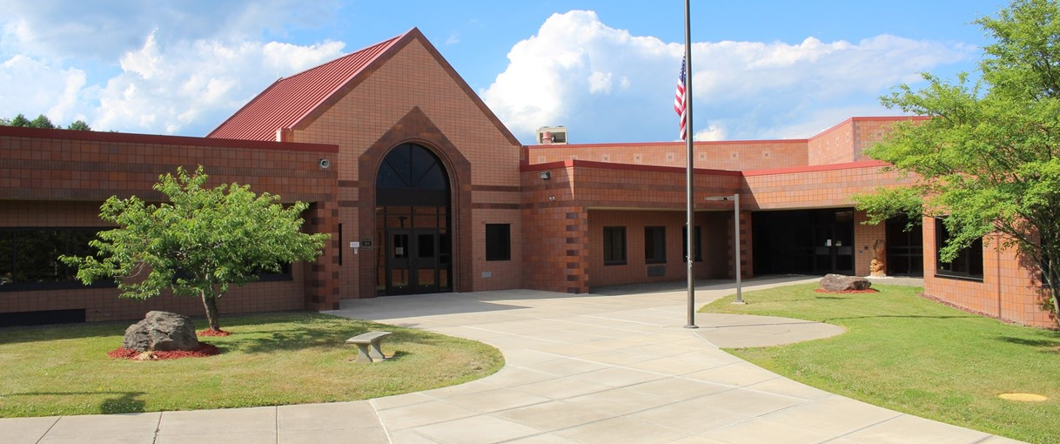
Gilbertsville-Mount Upton CSD
2023 Capital project
PRESENTED BY Arcadis IBI Group
March 15, 2023

Slide 2
––––
Agenda
Why a Capital Project
Financial Considerations
Proposed Project Scope
Proposed Schedule

Slide 3
––––
Why a Capital Project at this Time
Last major project completed in 2018
Ongoing yearly capital outlay projects
Facility improvement needs
Debt service coming off line
Health and safety of students

Slide 4
Financial Considerations

Slide 5
––––
Proposed Project Based On:
$5.2M capital project
85.6% building aid ratio
$4.2M in state aid
Aid beginning in 2025-26
District contribution - $1M (from capital reserve & available funds)
$0 tax impact

Slide 6
Proposed Project Scope
Sitework

Slide 7
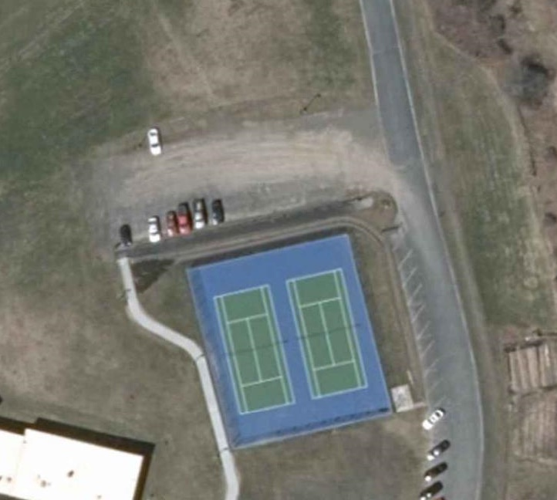
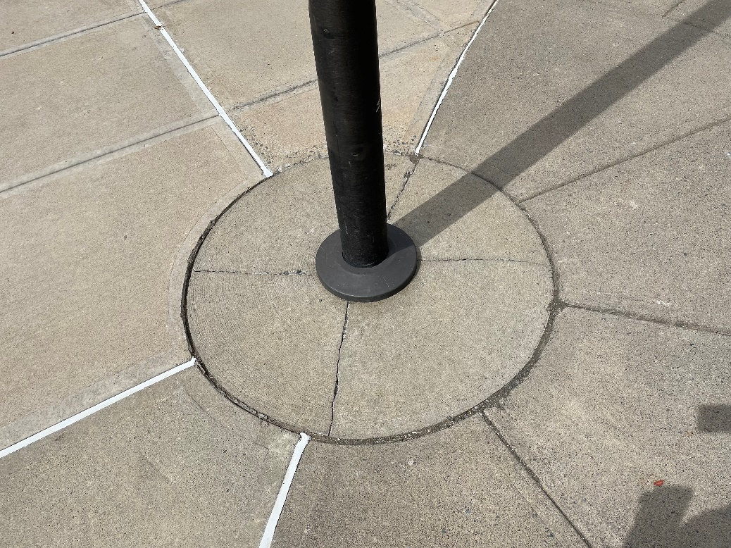
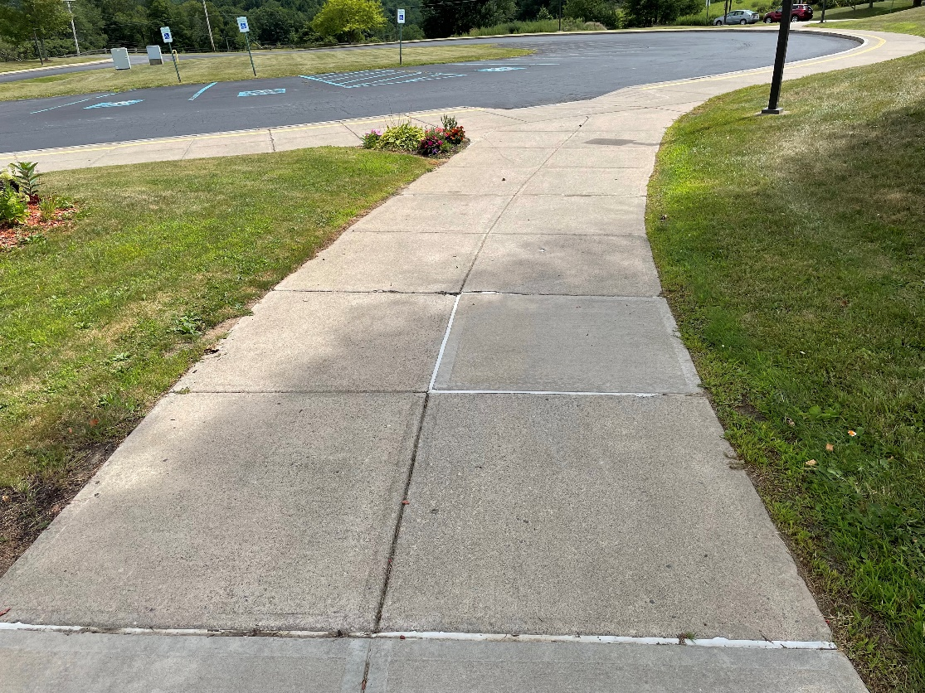
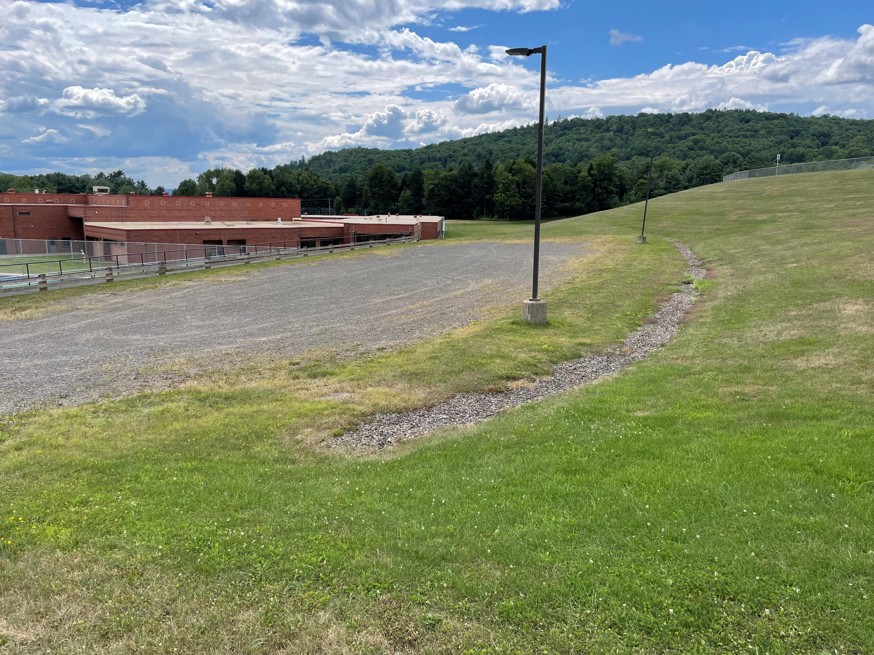
––––
South Parking Lot Upgrade
Sidewalk Replacement

Slide 8
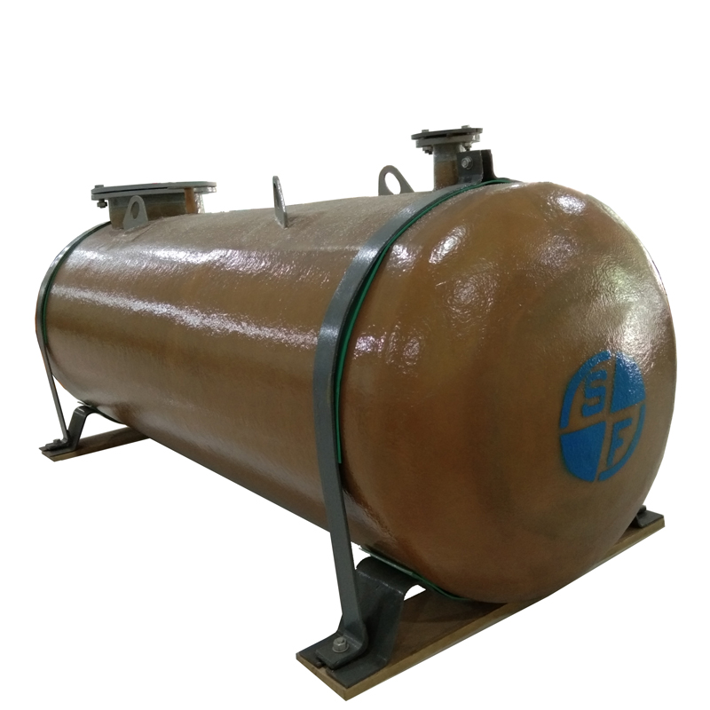
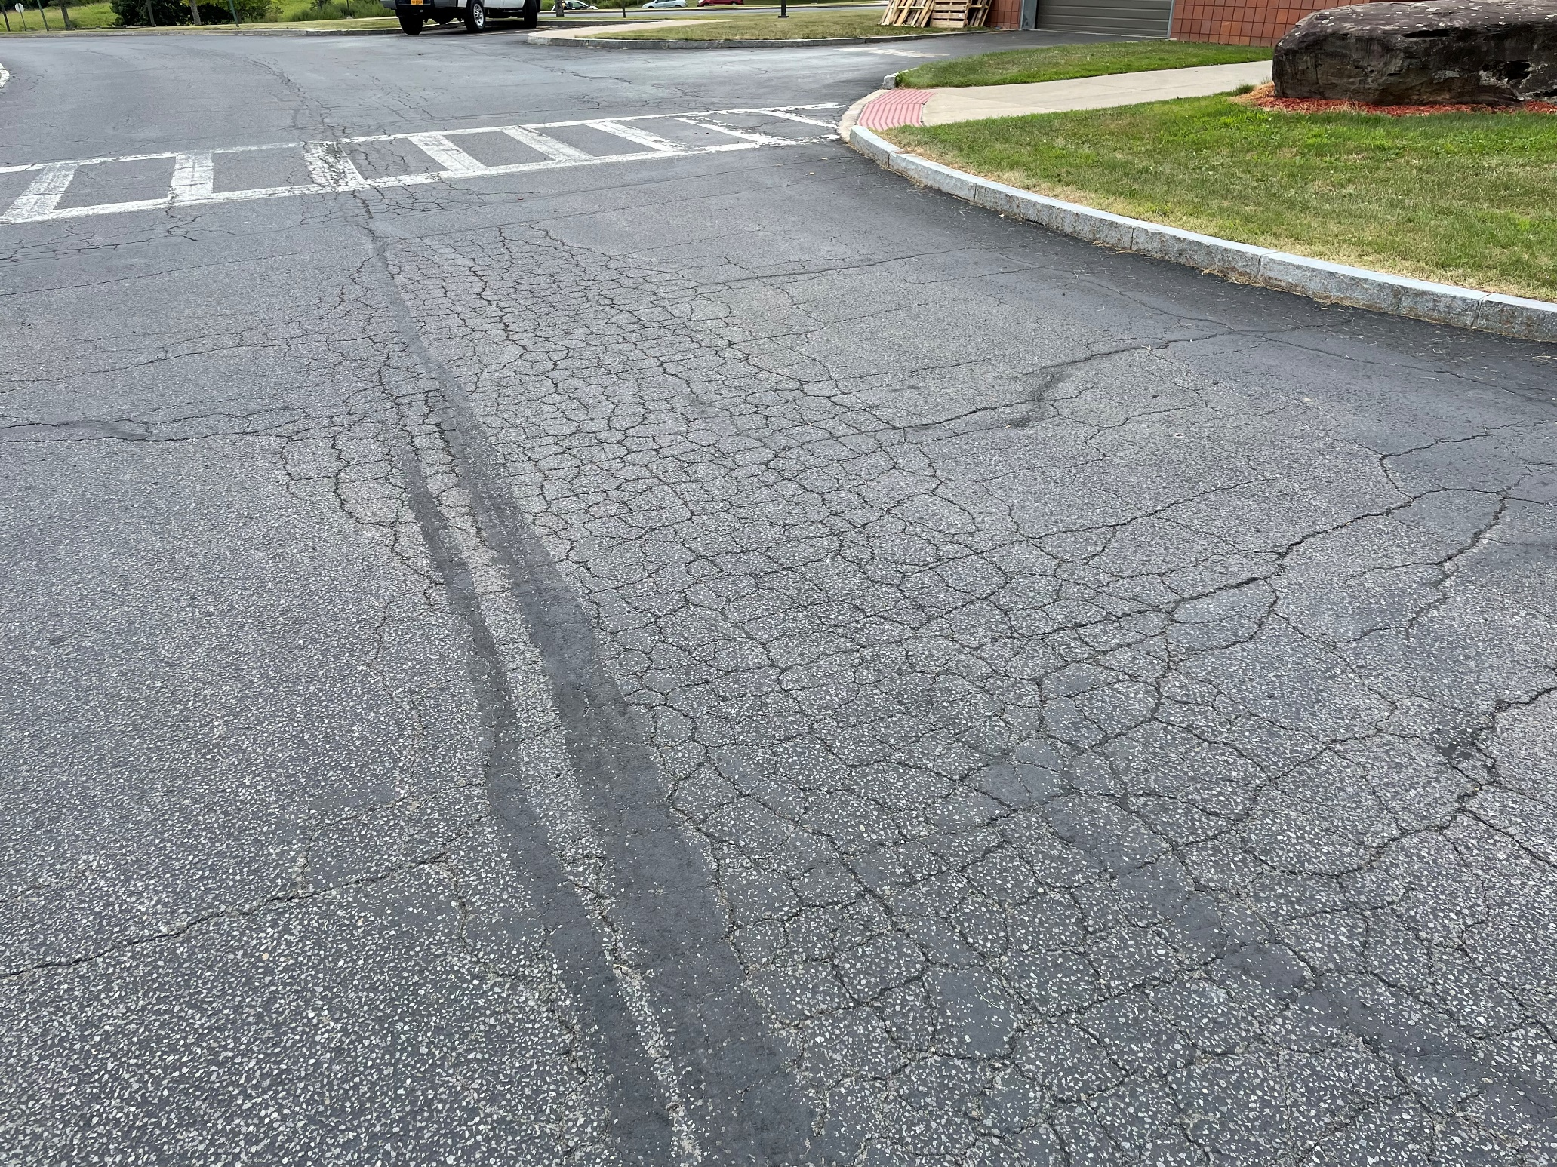
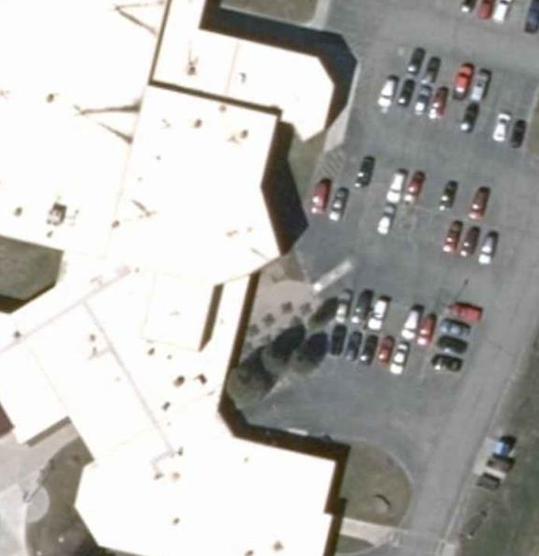
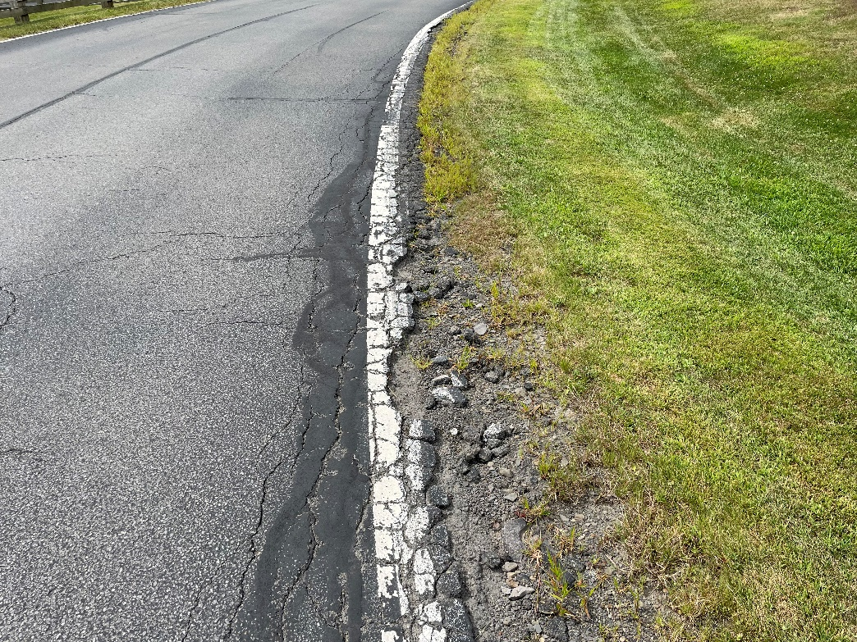
––––
Underground Storage Tank Replacement
Driveway and Parking Lot Reconstruction

Slide 9
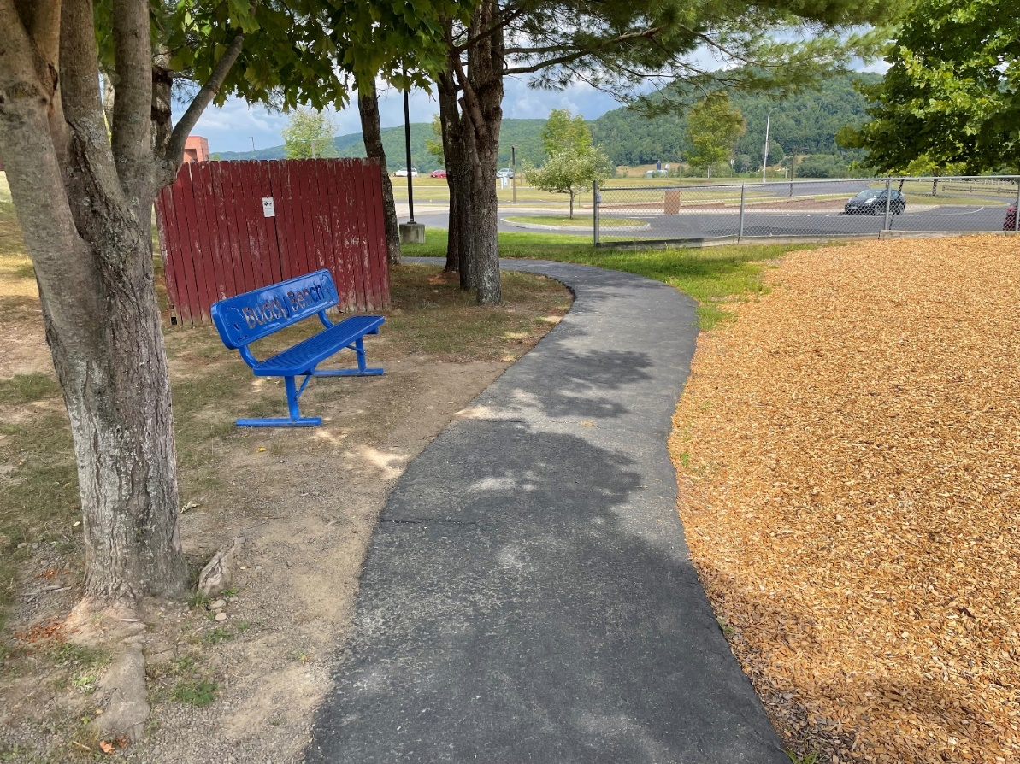
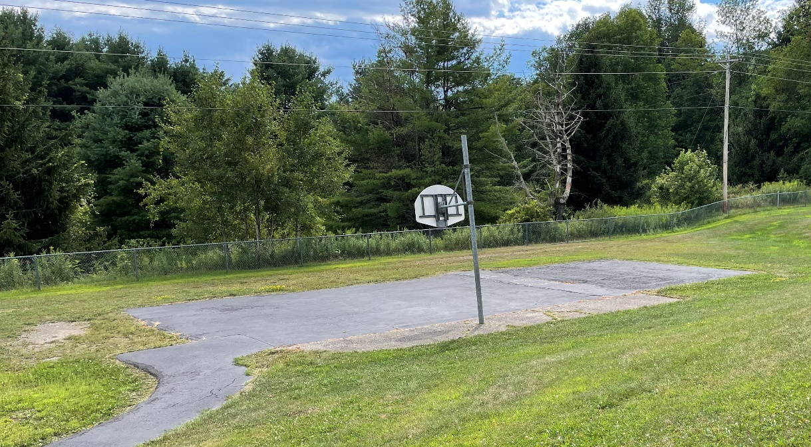
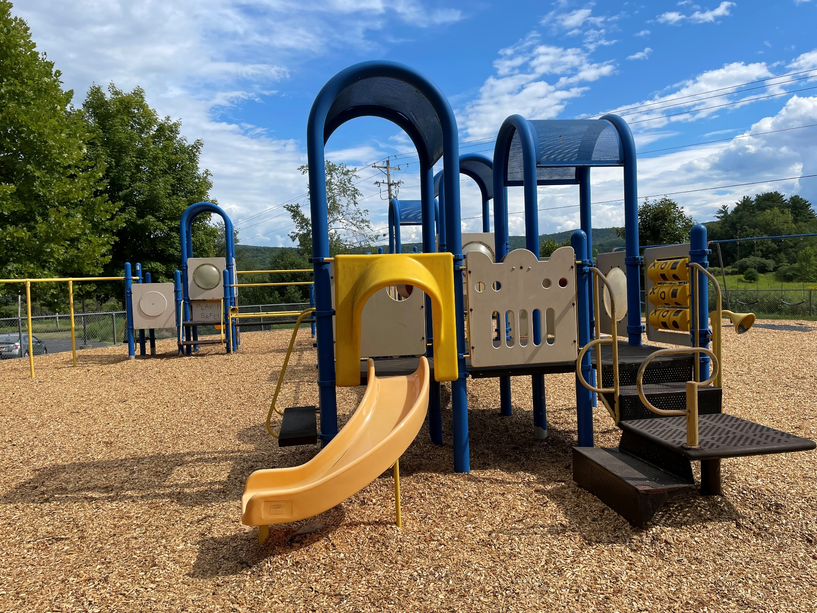
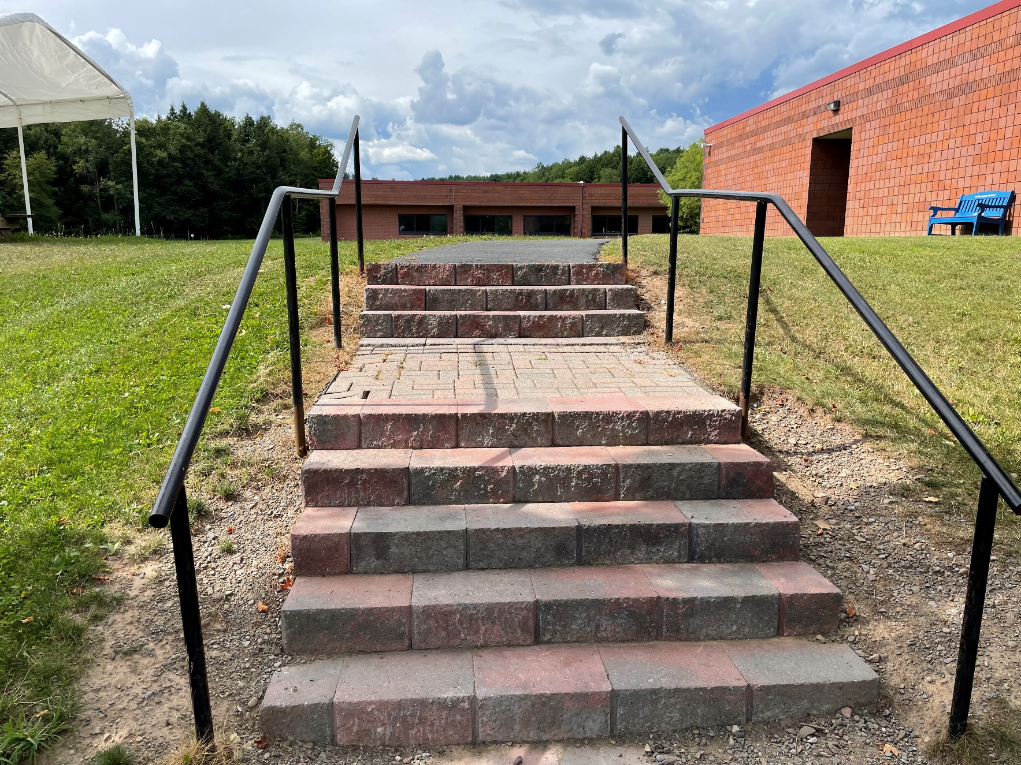
––––
Stair and Sidewalk Reconstruction
Playground Replacement

Slide 10
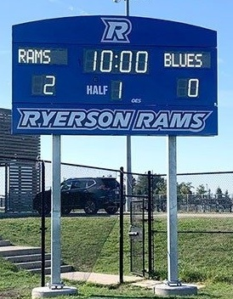
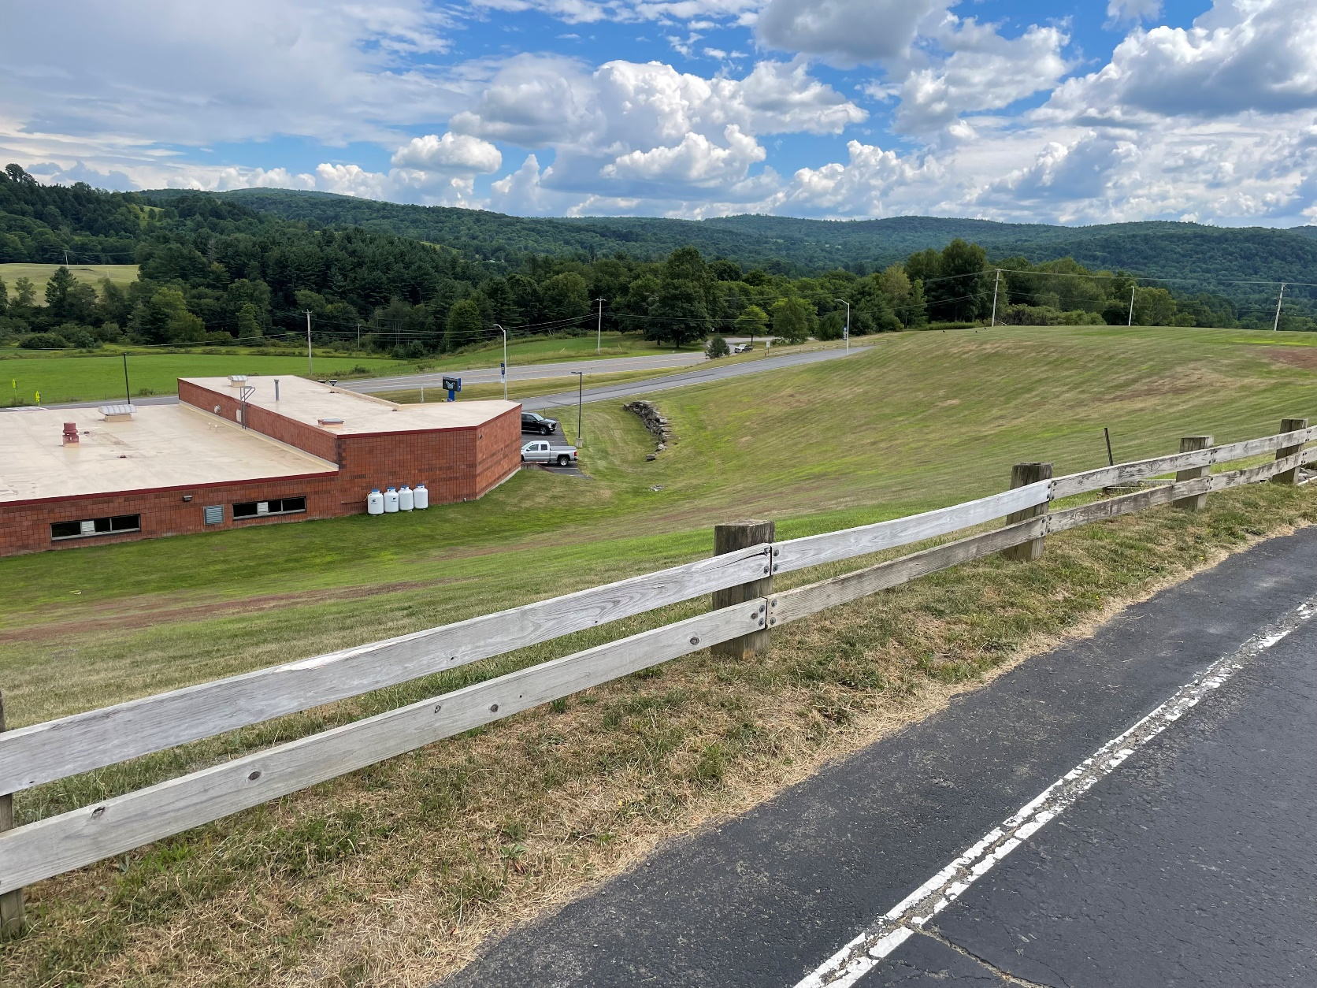
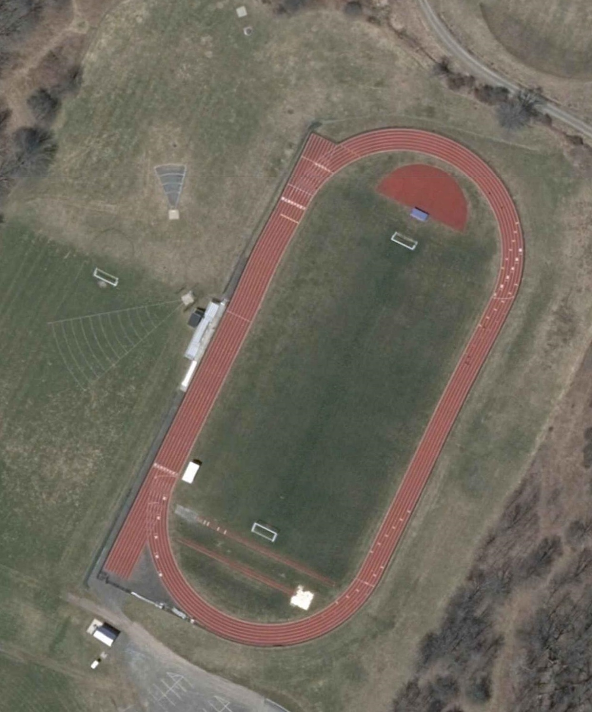
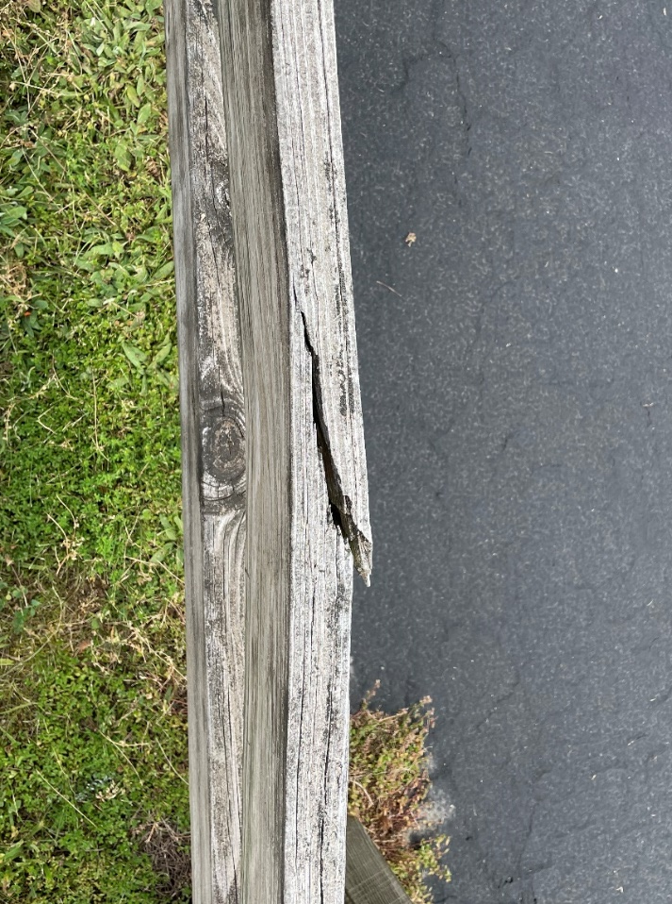
––––
Soccer Scoreboard (alternate)
Wood Guardrail Replacement

Slide 11
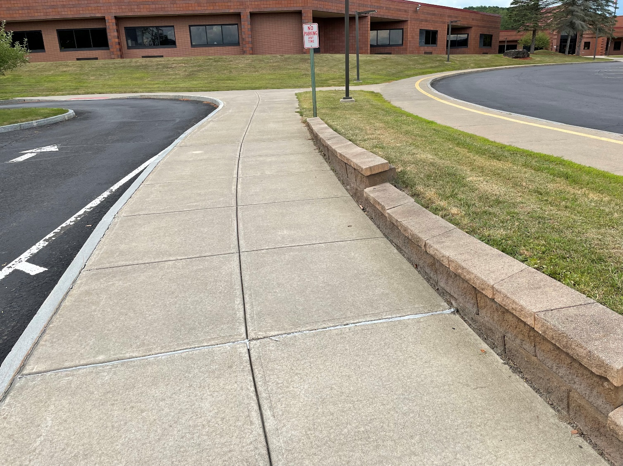
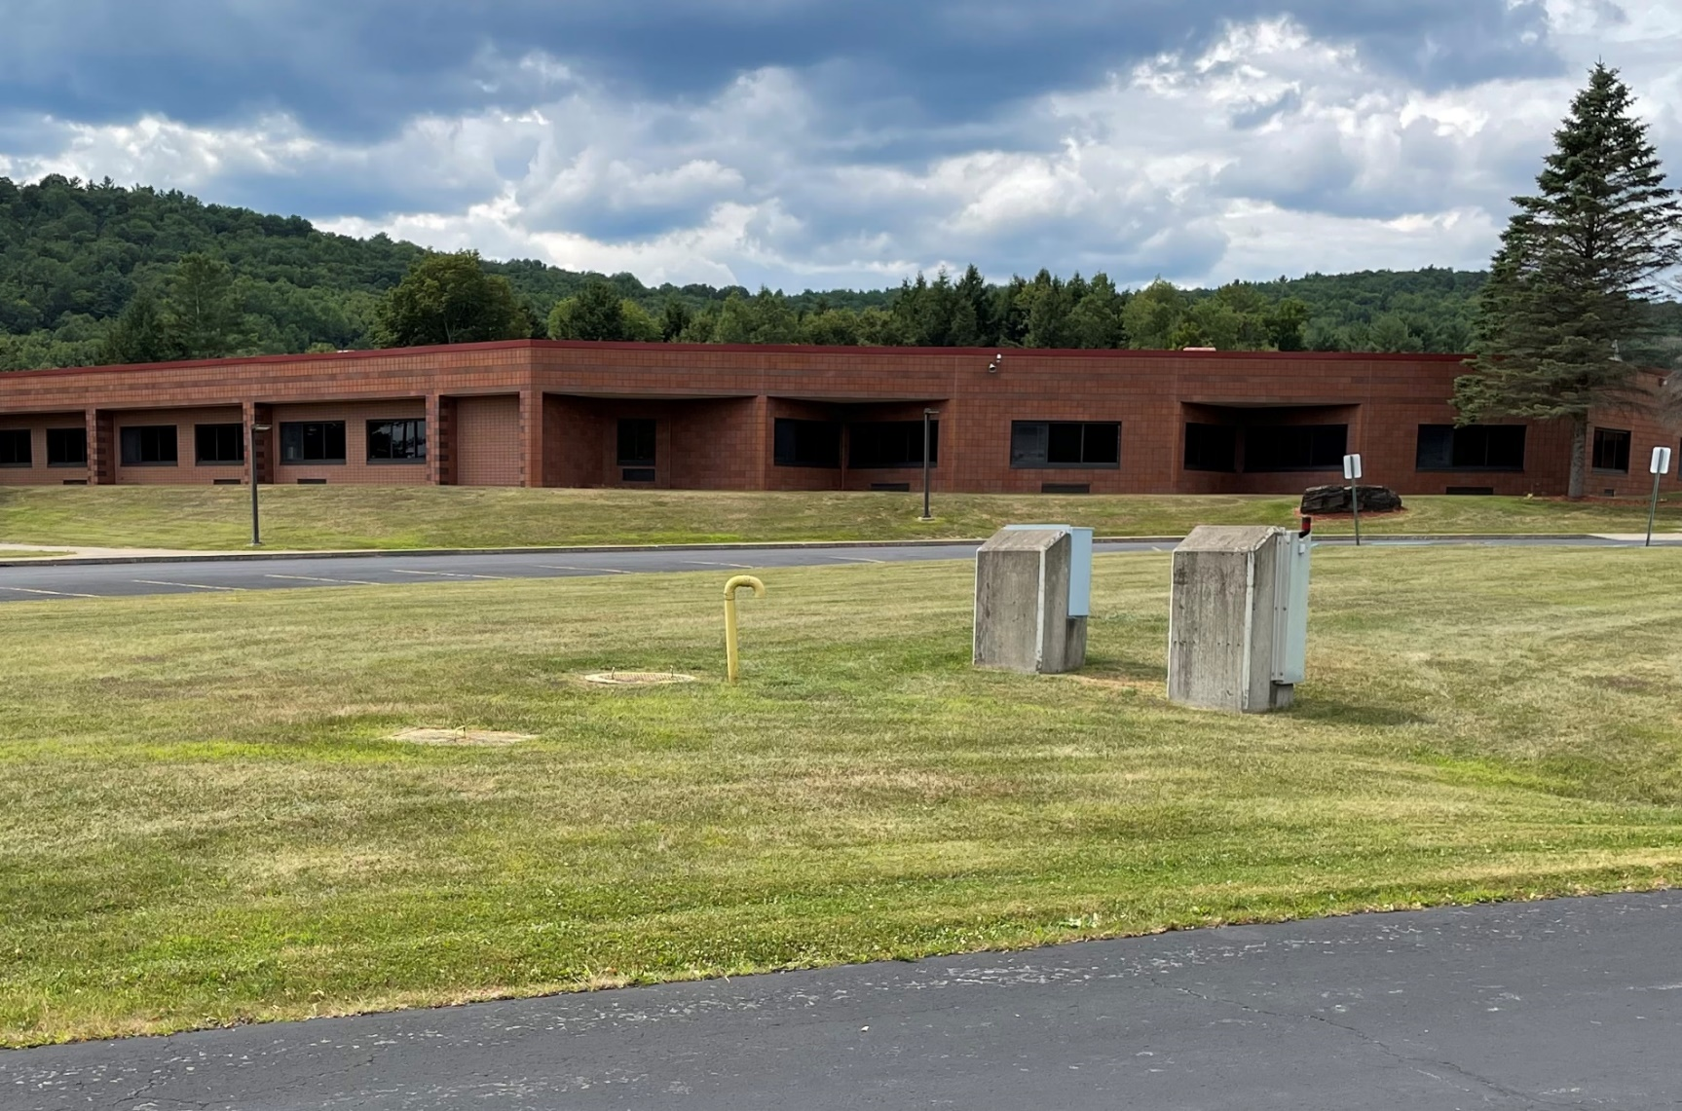
––––
Retaining Wall Reconstruction
Septic Dosing Valves & Piping Replacement

Slide 12
Potential Project Scope
Building Exterior

Slide 13
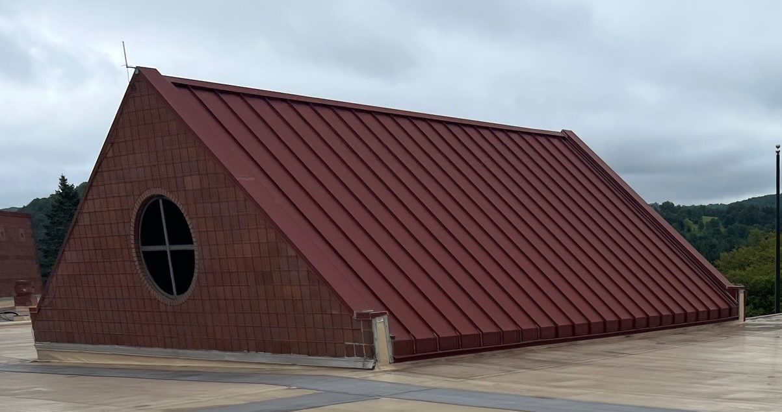
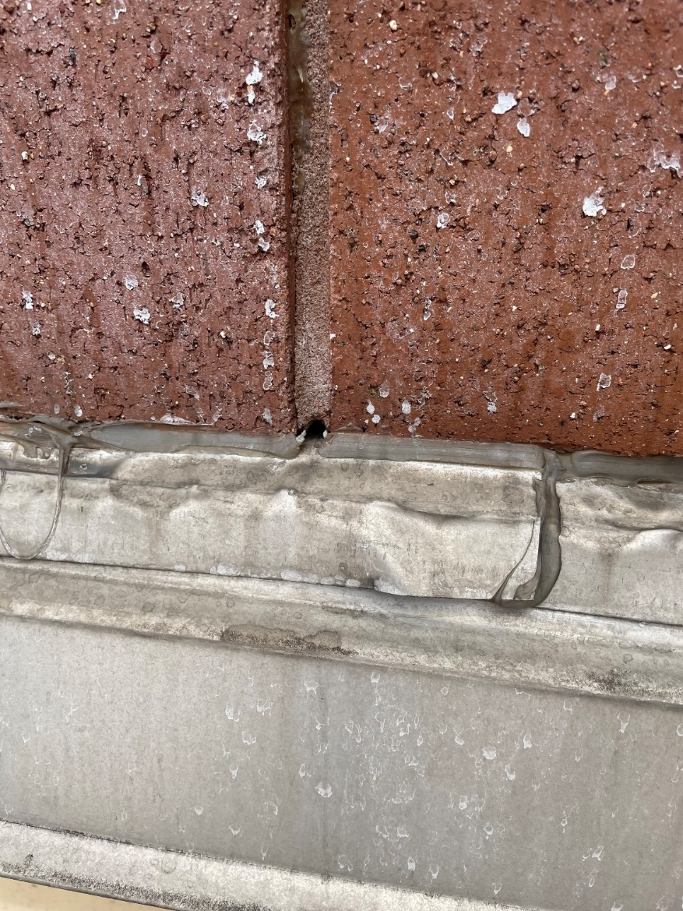
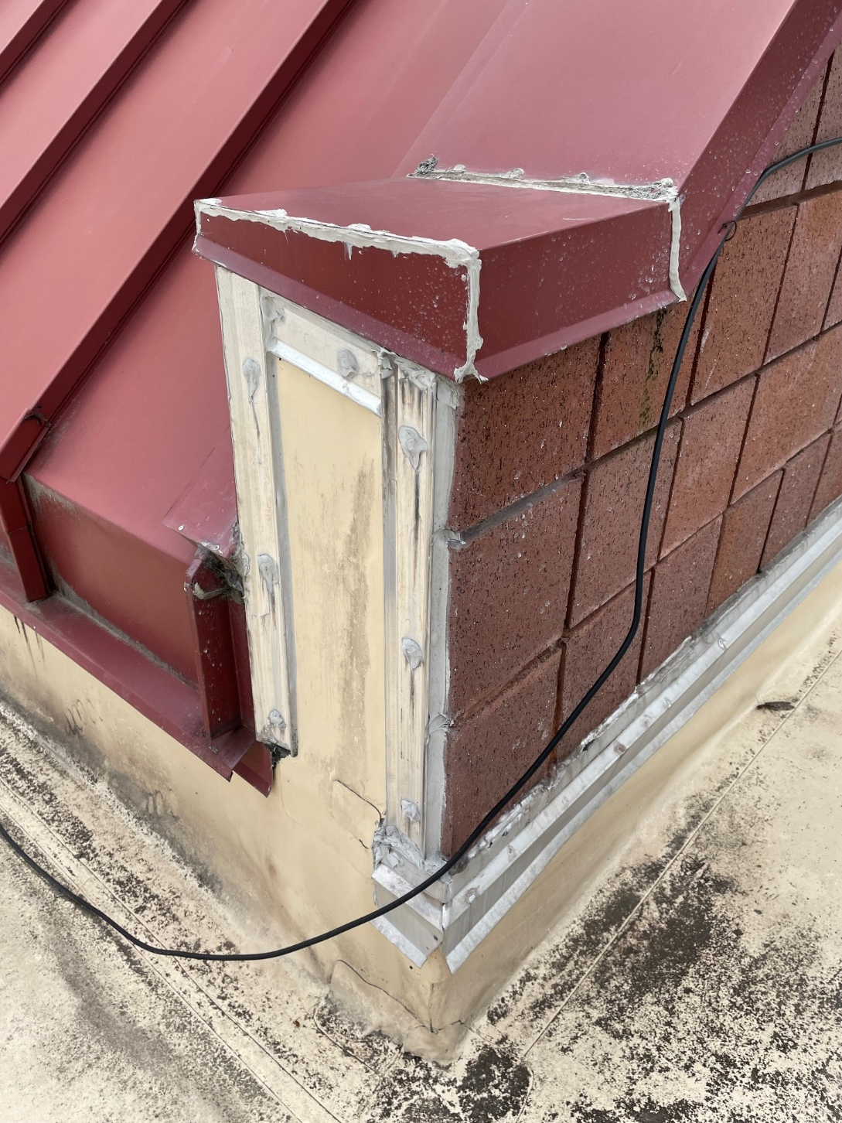
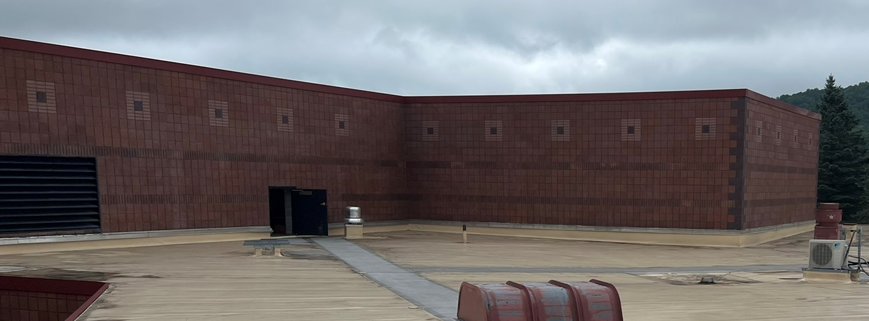
––––
Through-Wall Flashing Repair
Metal Roof Coating

Slide 14
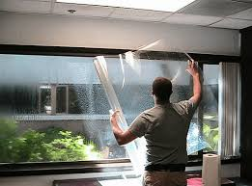
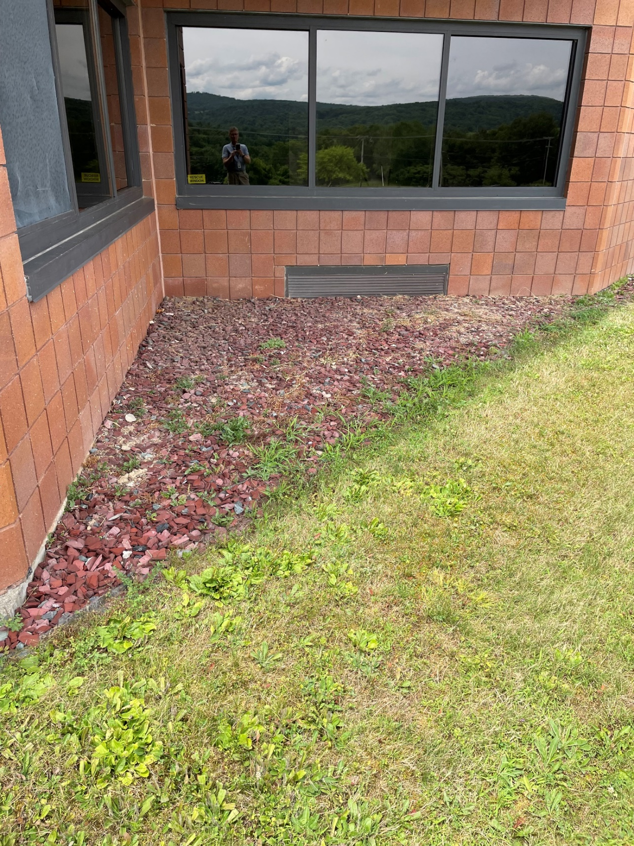
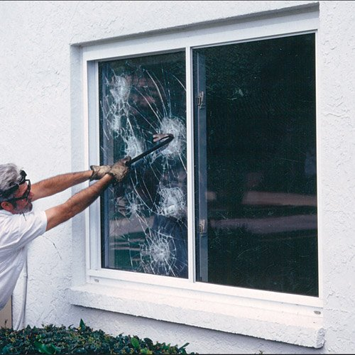
––––
Security Film at Exterior Glass (alternate)

Slide 15
Proposed Project Scope
Building Interior

Slide 16
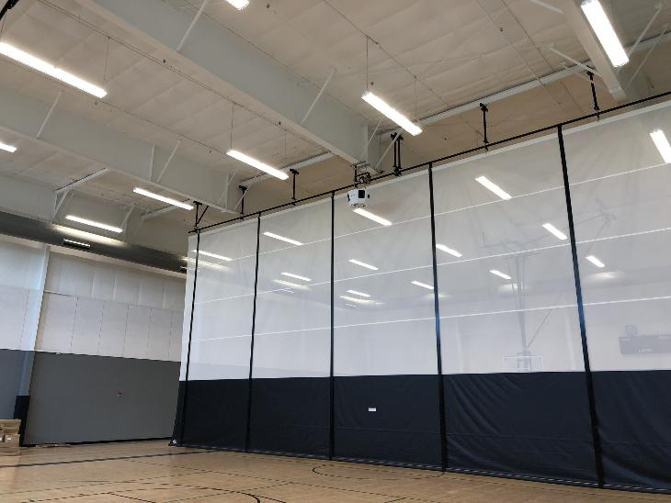
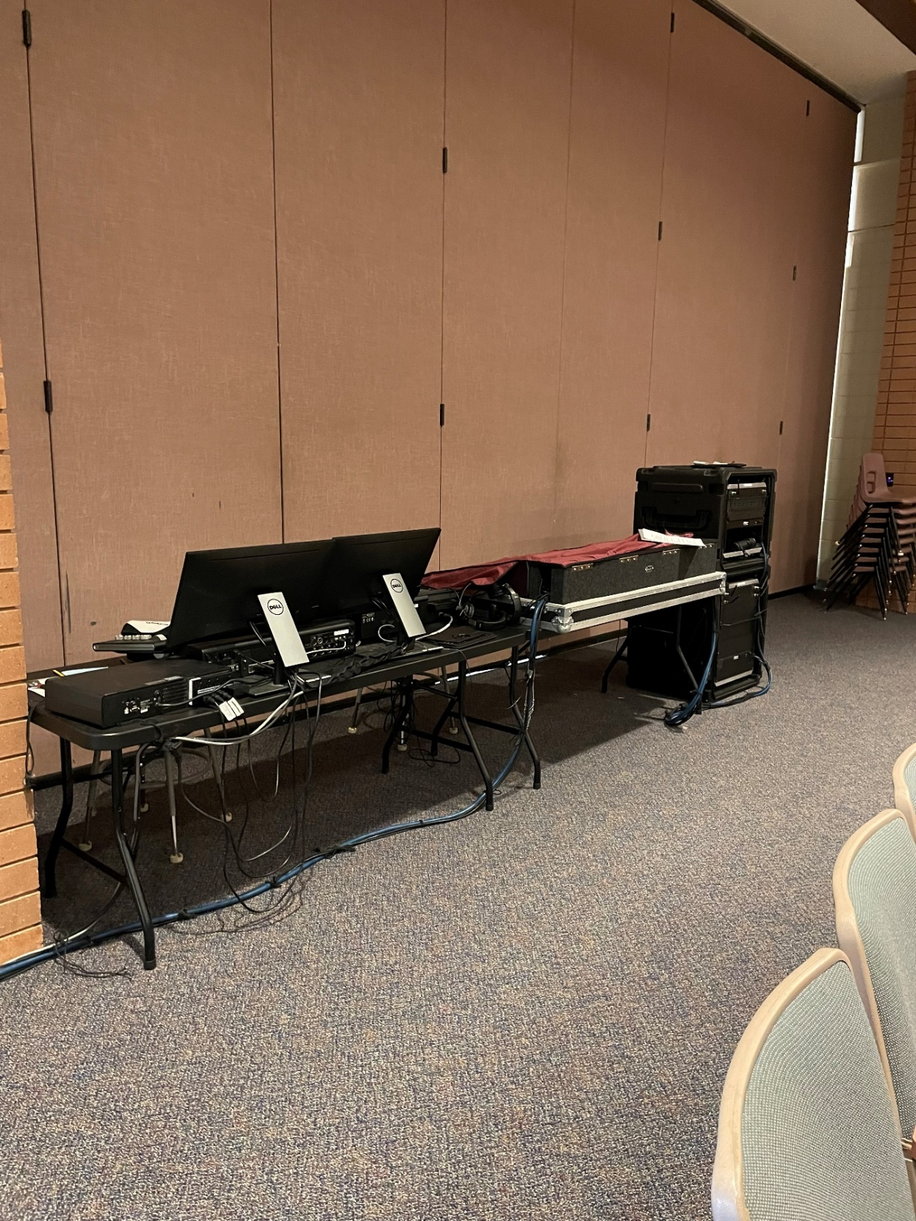
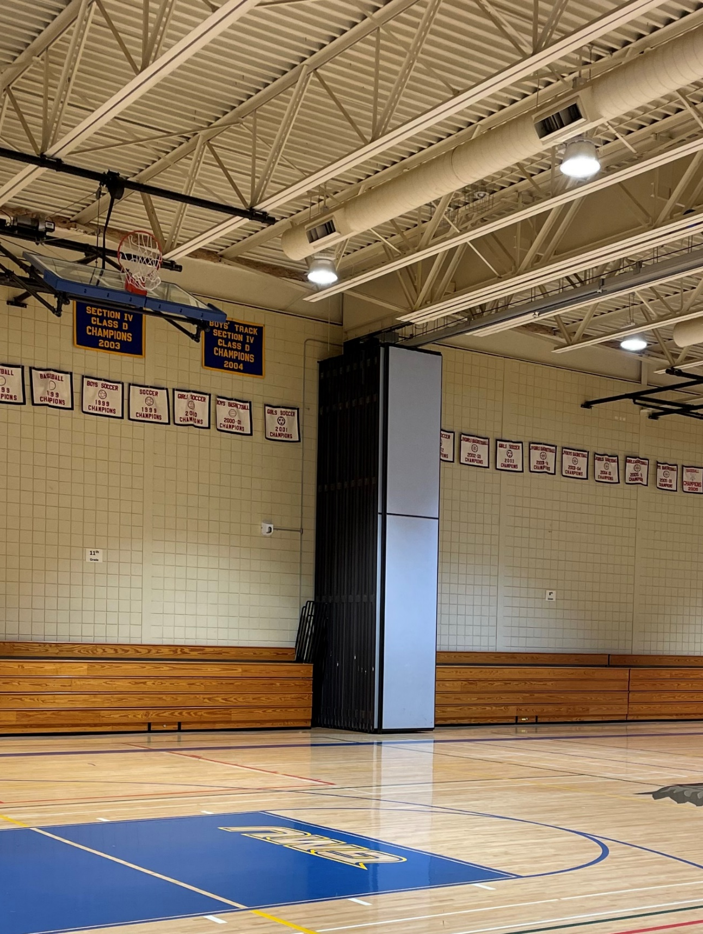
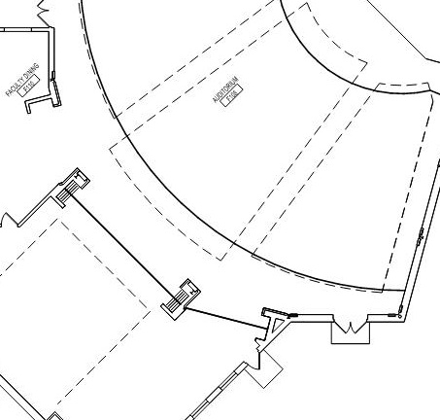
––––
Auditorium Control Booth
Gymnasium Curtain

Slide 17
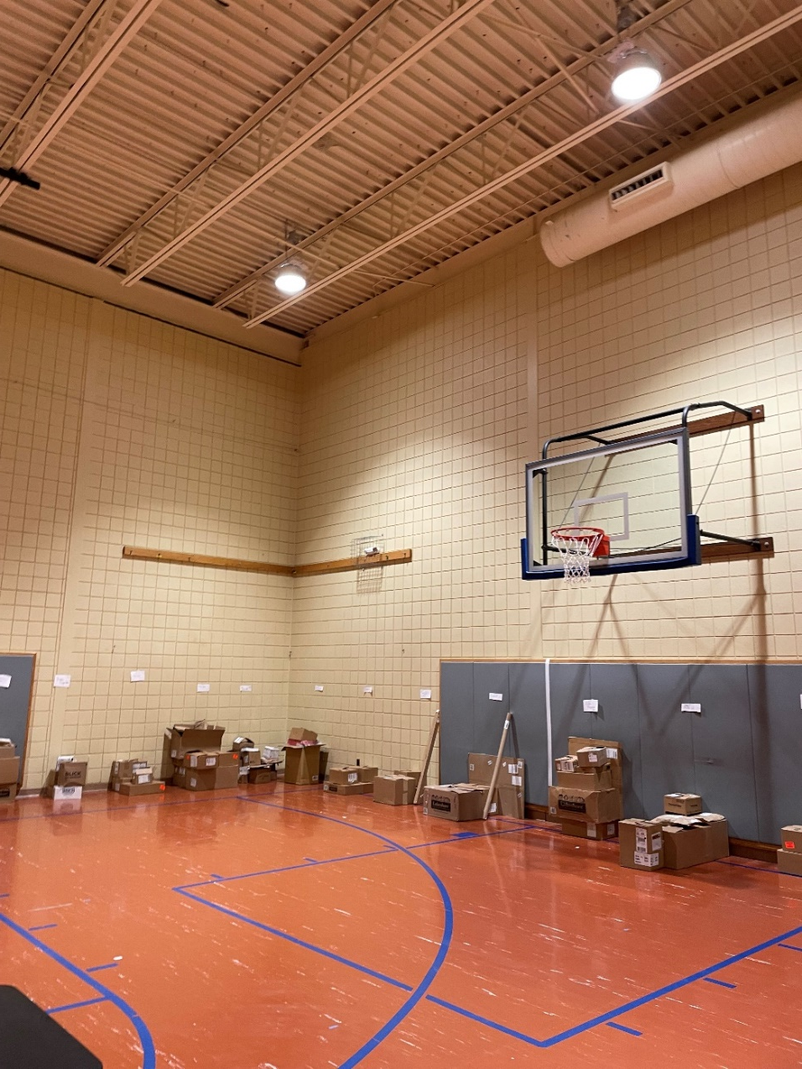
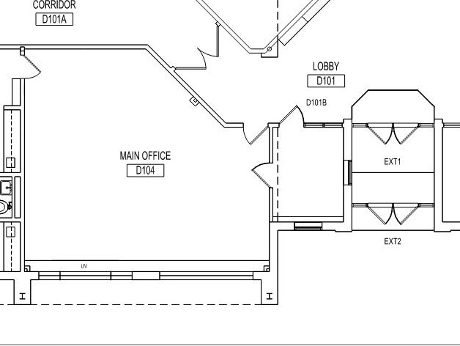
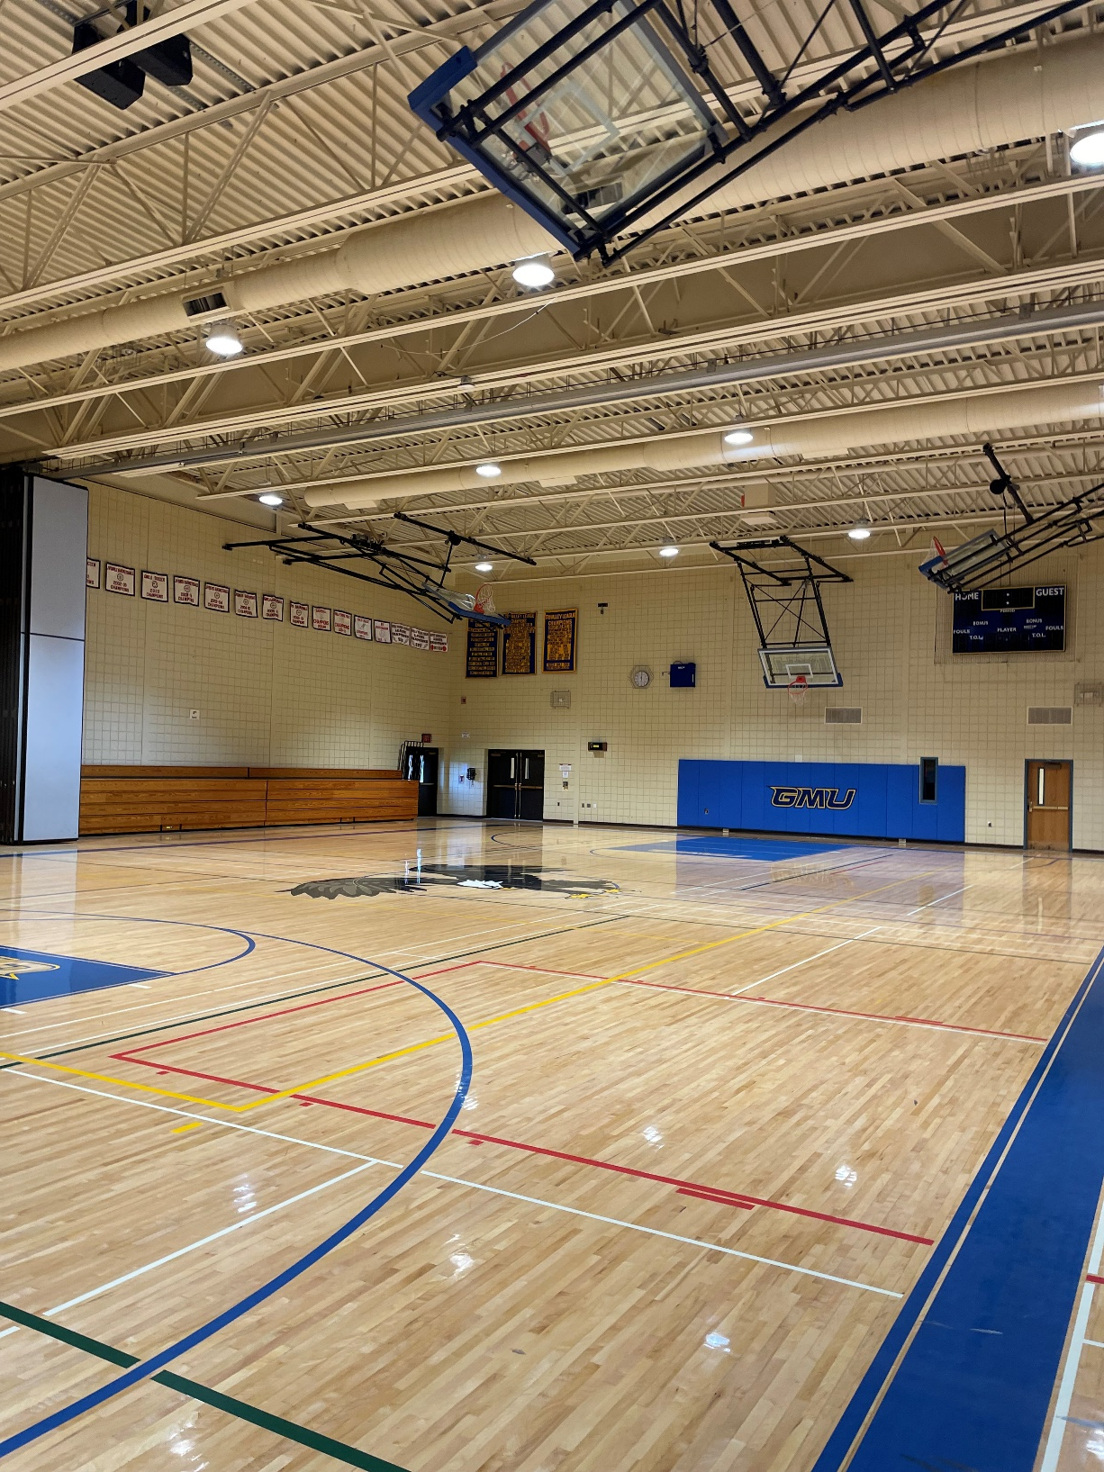
––––
Main Office Renovation
Gym Painting

Slide 18
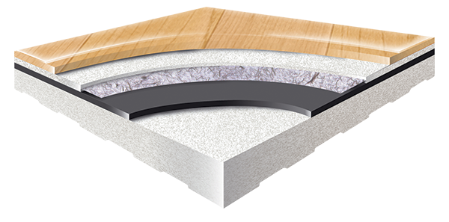
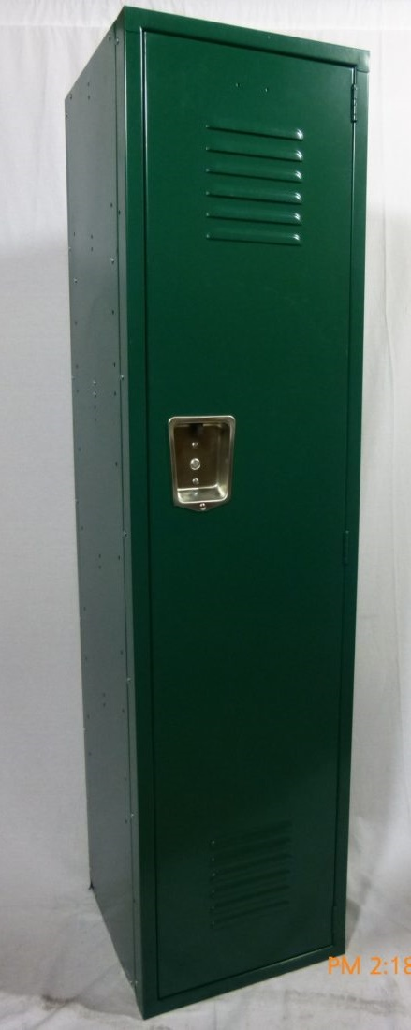
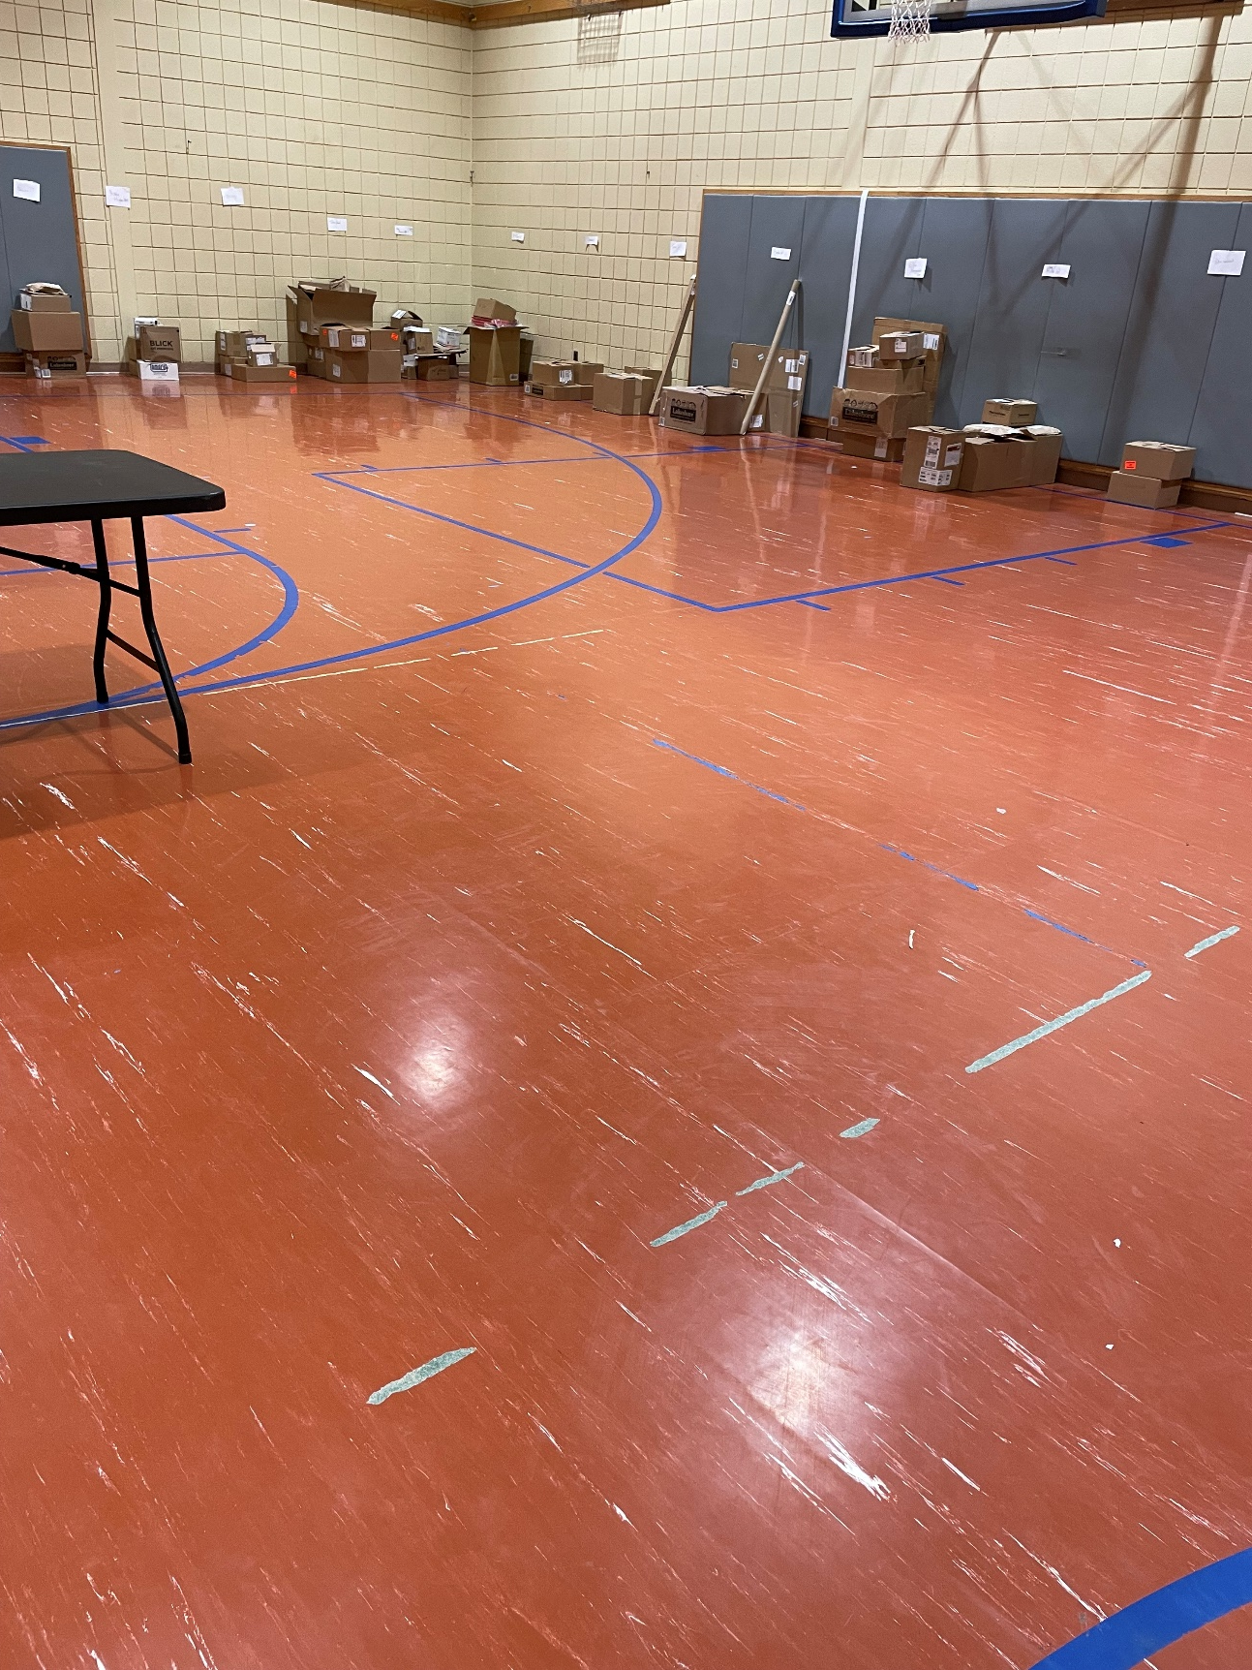
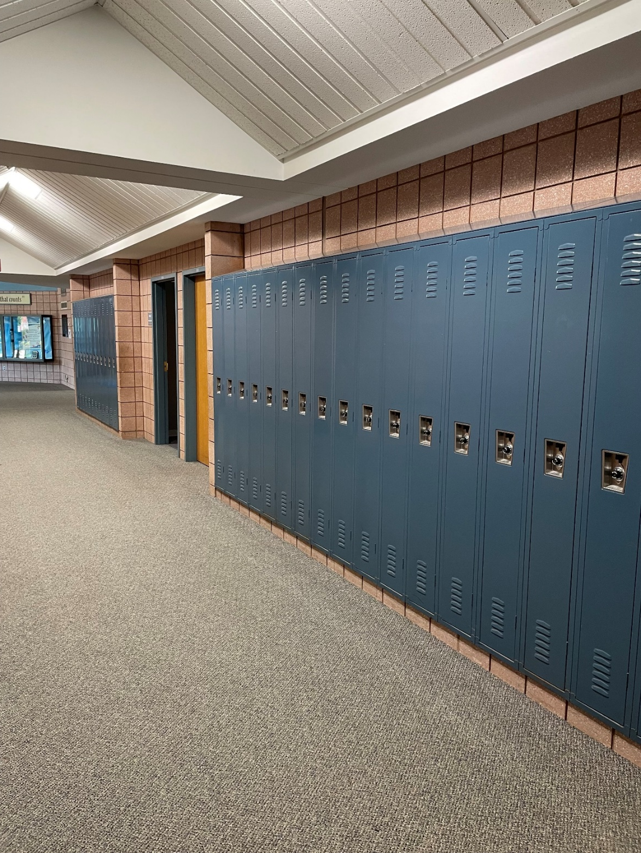
––––
Elementary Gym Floor Replacement
Corridor Locker Replacement

Slide 19
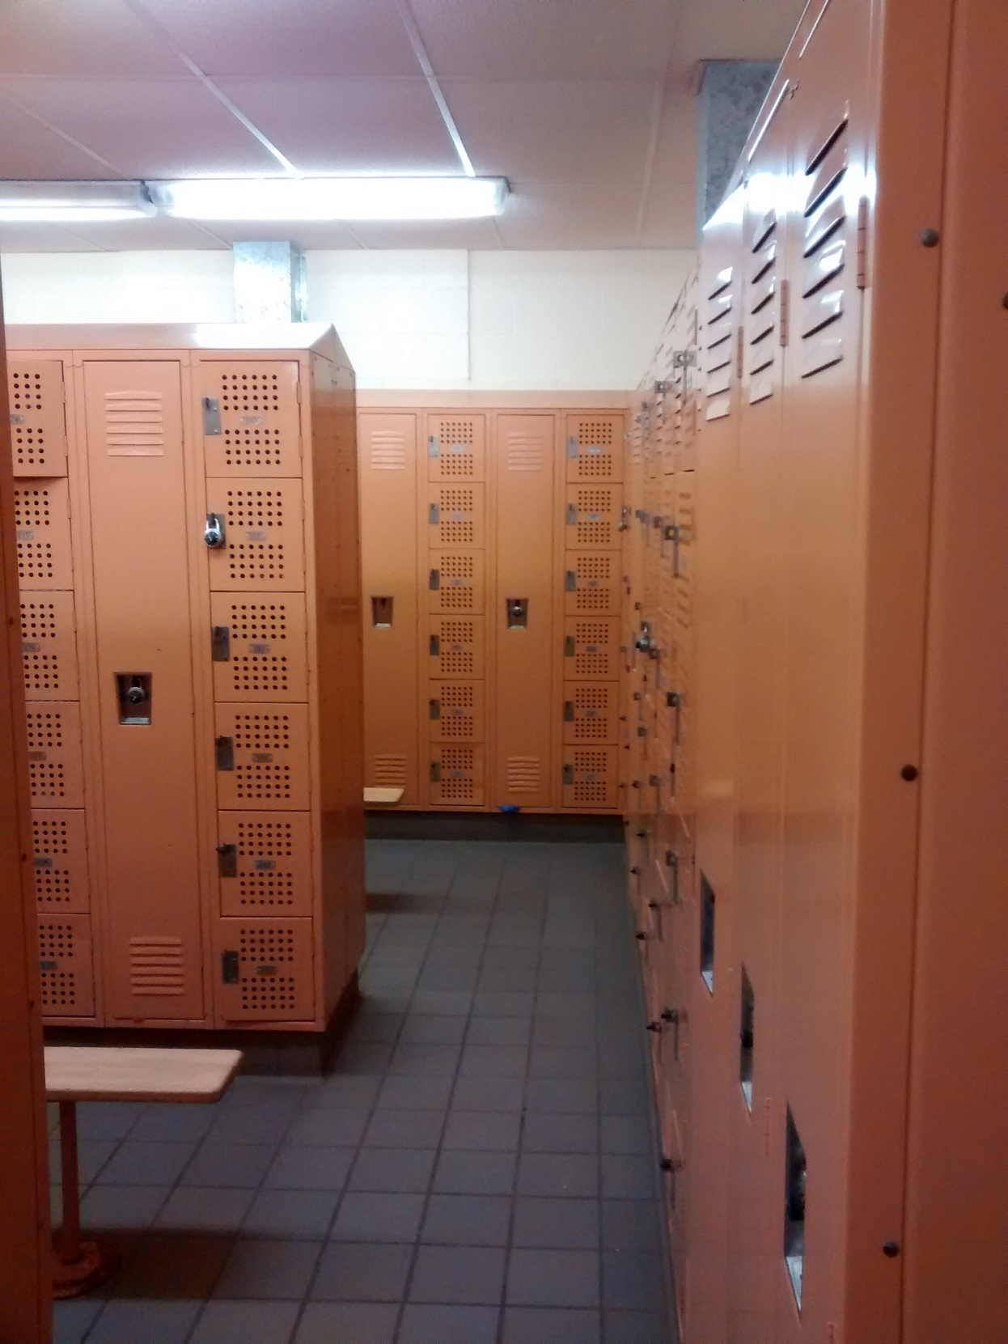
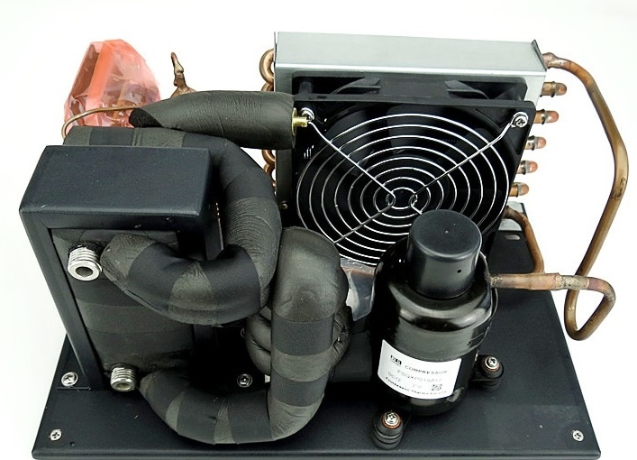
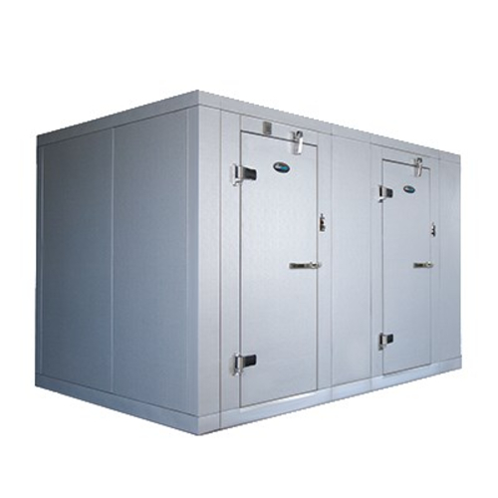
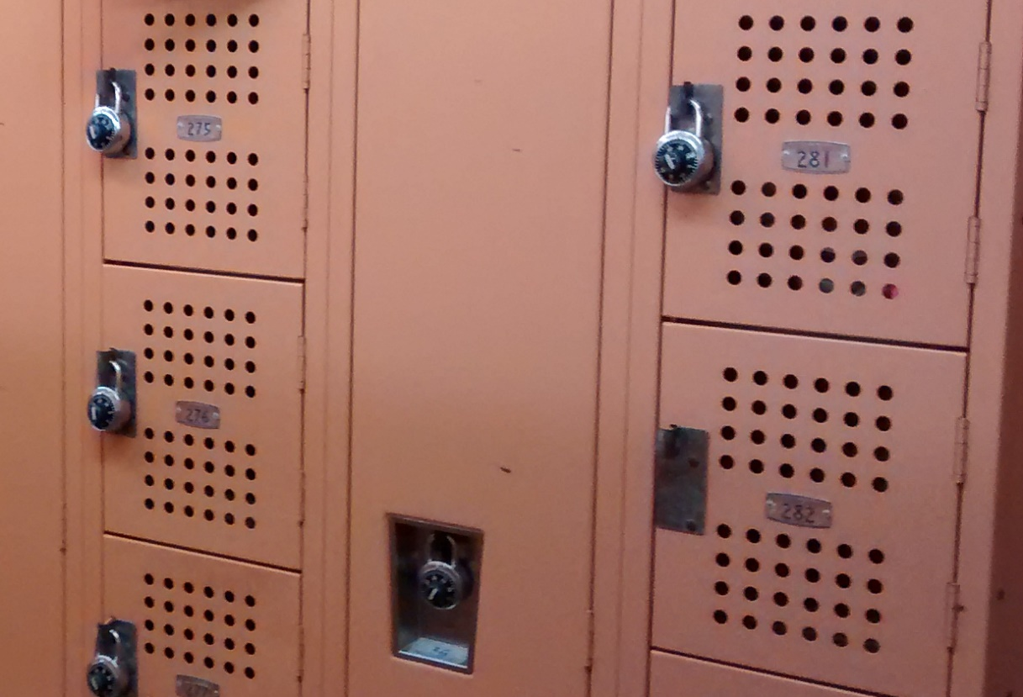
––––
Girls Locker Room Locker Replacement
Cooler/Freezer Upgrades

Slide 20
Proposed Project Scope
Mechanical/Electrical/Plumbing

Slide 21
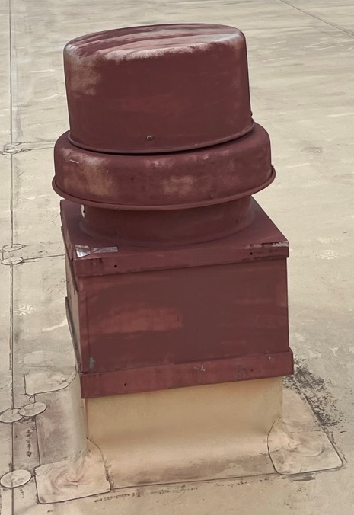
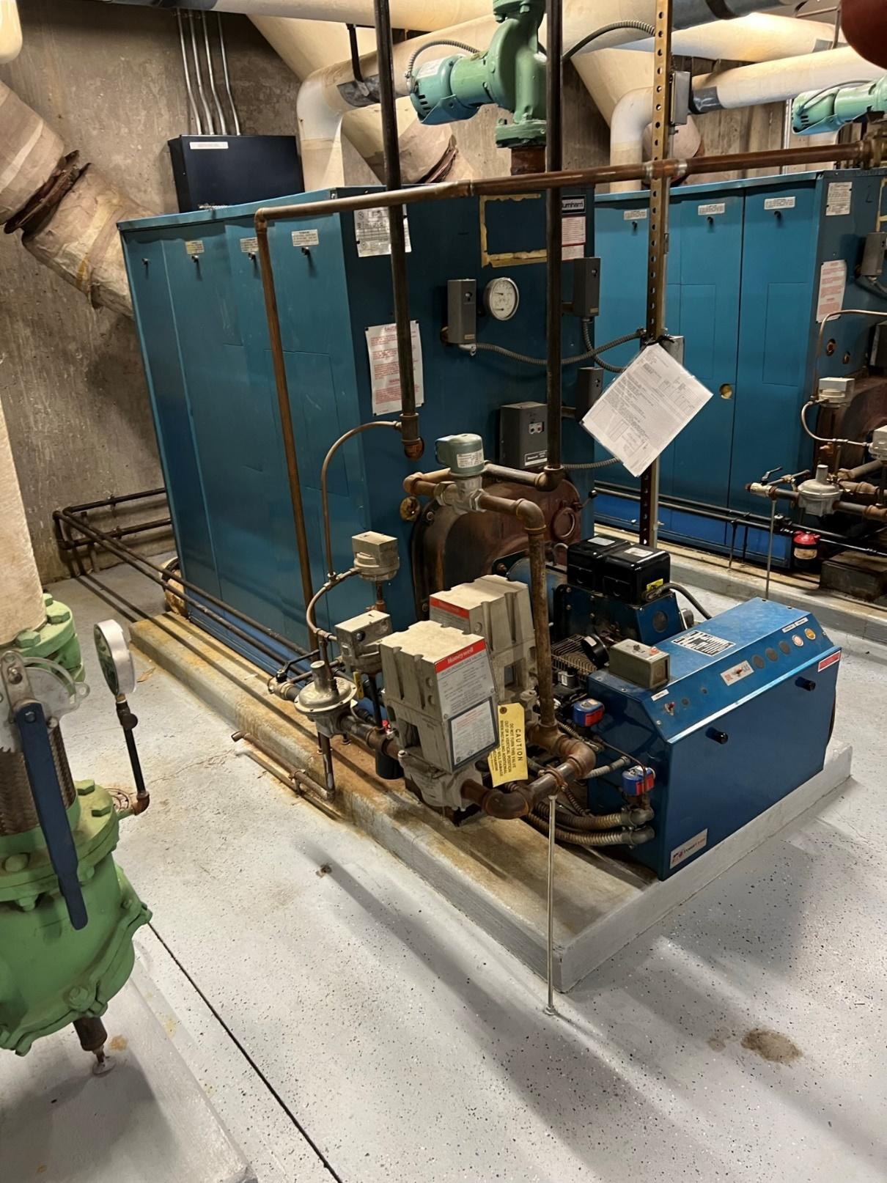
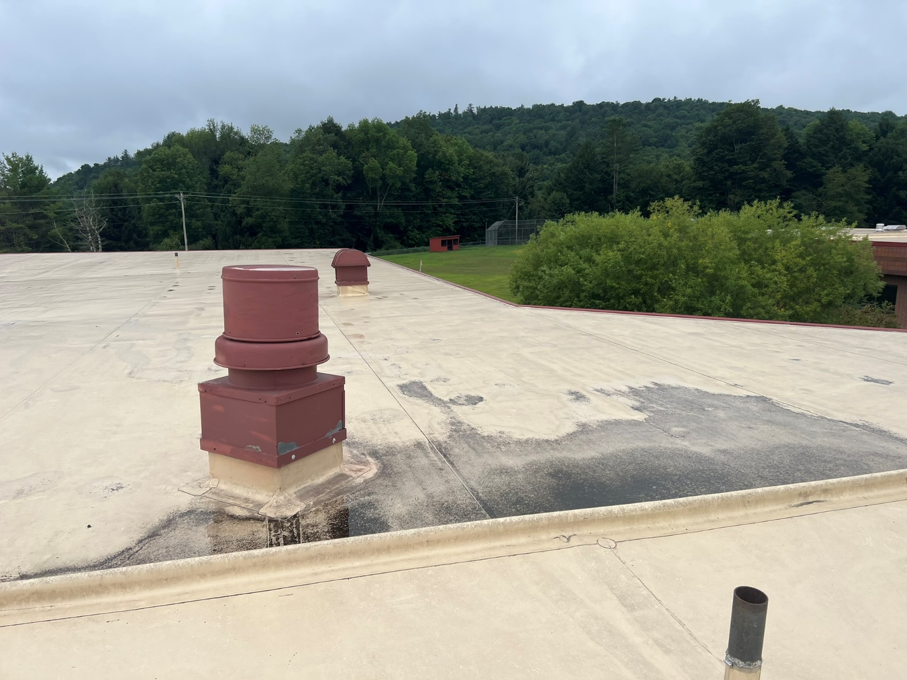
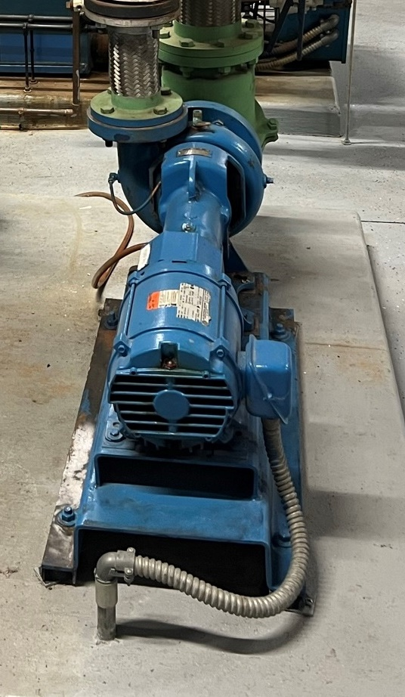
––––
Boiler Replacement
Exhaust Fan Replacement

Slide 22
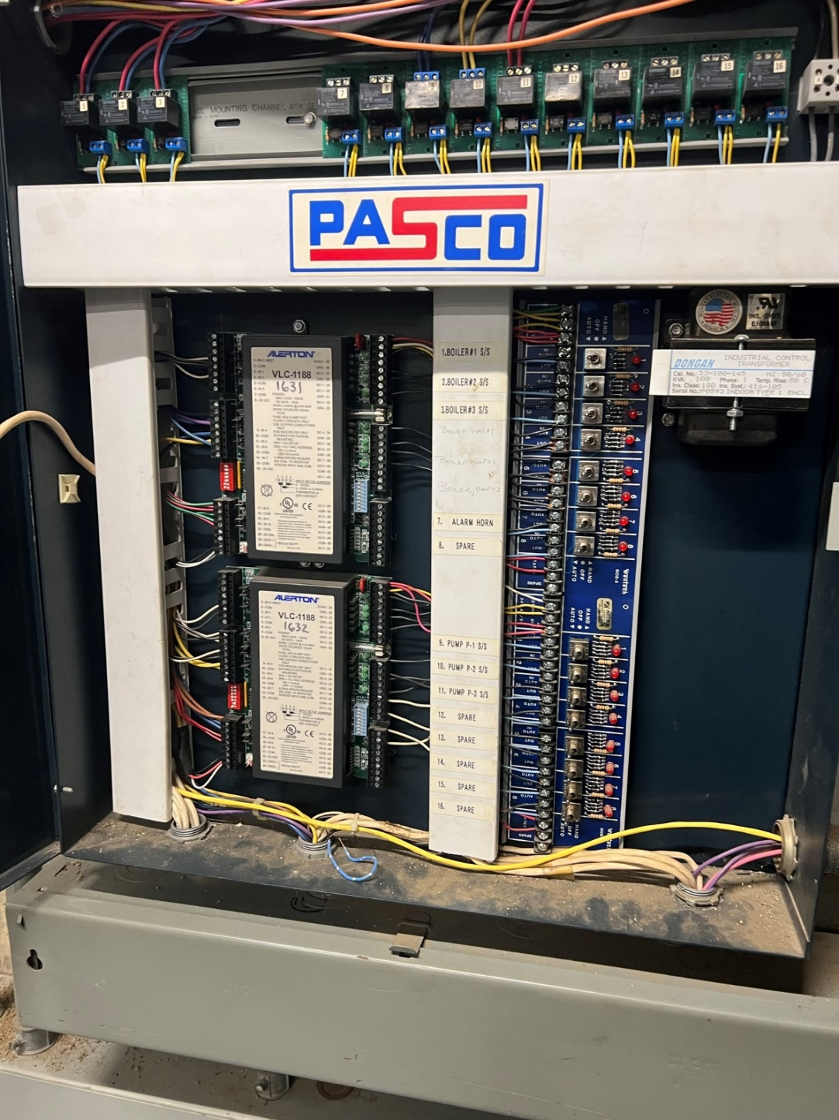
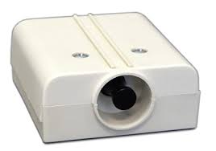
––––
Upgrade BMS System Front End
Panic Button

Slide 23
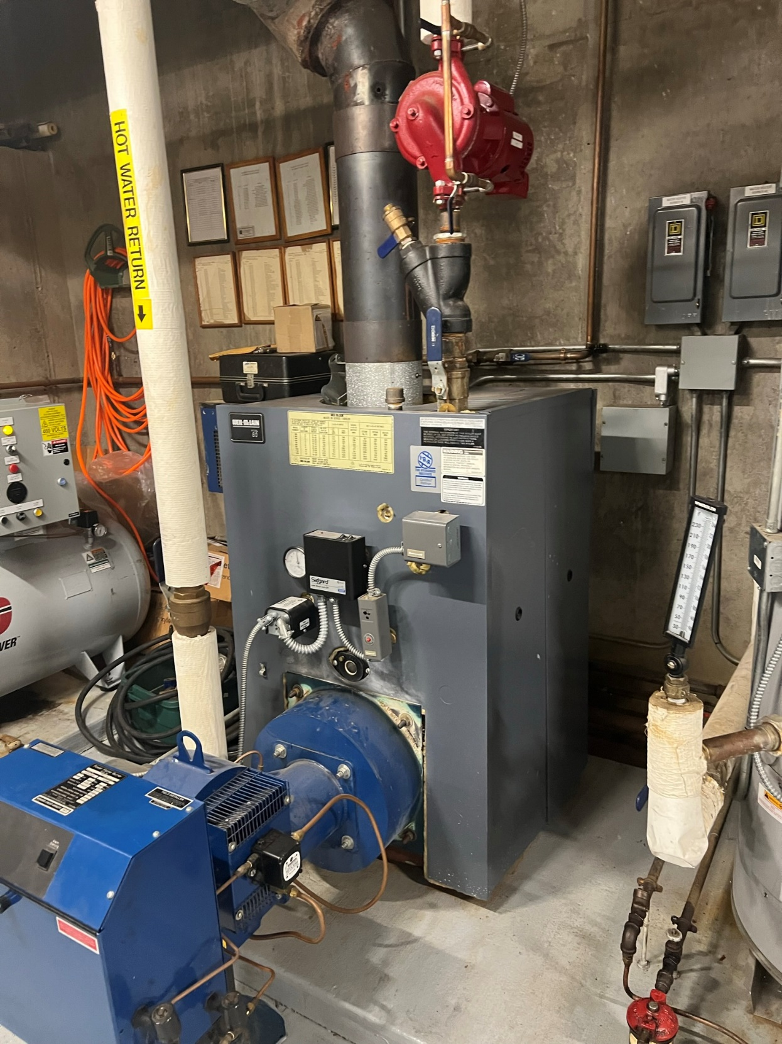
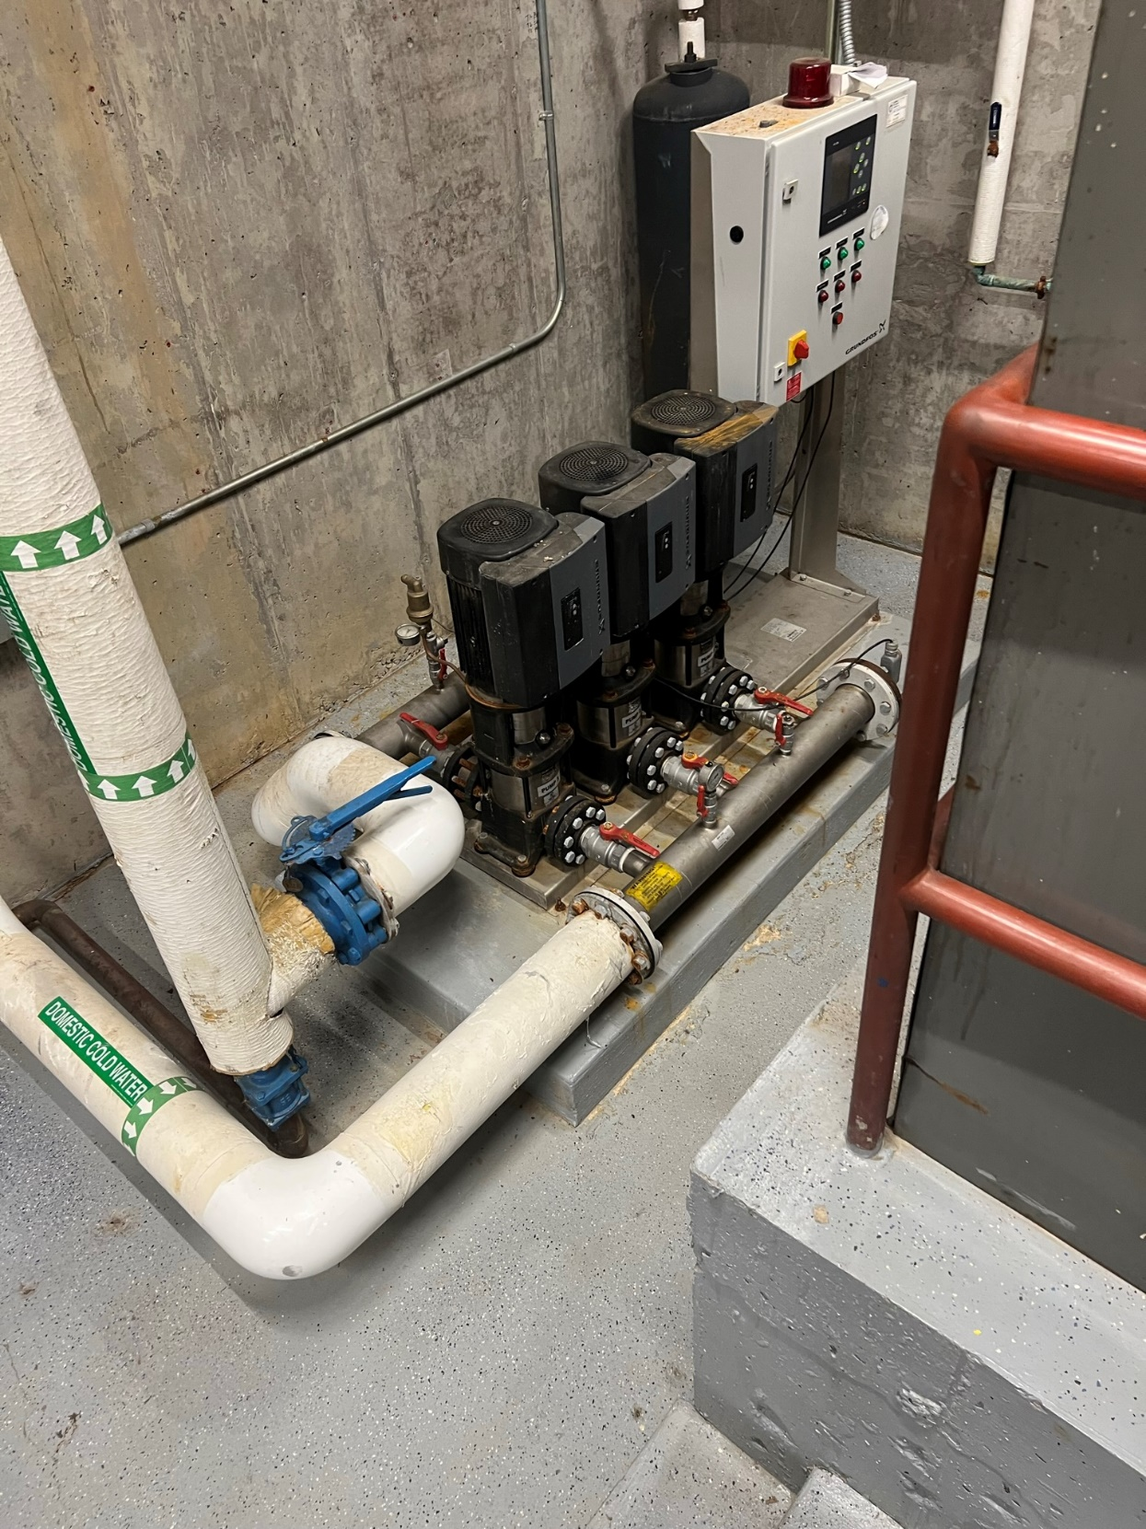
––––
Well Pump Controls Upgrade
Hot Water Boiler Replacement

Slide 24
––––
Proposed Timeline – Post Referendum
September - November 2023
February - June 2024
Design
SED Review
Bidding
Construction
Ordering Materials
May - September 2023
December - January 2024
June - August 2024

Slide 25
––––
Referendum Vote
Vote date - May 16, 2023
$5.2M Capital Project
PROPOSITION
RESOLVED, the Gilbertsville-Mount Upton Central School District, Otsego and Chenango Counties, New York, shall be authorized to construct improvements to and reconstruct the School District building and campus facilities, including site improvements, original furnishings, equipment, machinery, apparatus, appurtenances, and incidental improvements and expenses in connection therewith, at a maximum estimated cost of $5,200,000, and that $116,147 of 2015 Capital Reserve Fund monies, $500,000 of 2016 Capital Reserve Fund monies, and $383,853 of available monies shall be expended therefor, and that the remaining $4,200,000 or so much thereof as may be necessary, shall be raised by the levy of a tax upon the taxable property of said School District and collected in annual installments as provided by Section 416 of the Education Law; and in anticipation of such tax, obligations of said School District shall be issued.

Slide 26
Thank You!
Follow Us
Key Contact
Steve Thesier
Associate Director
607.772.0007 ext 52028
Steve.Thesier@ibigroup.com

